Slide 1
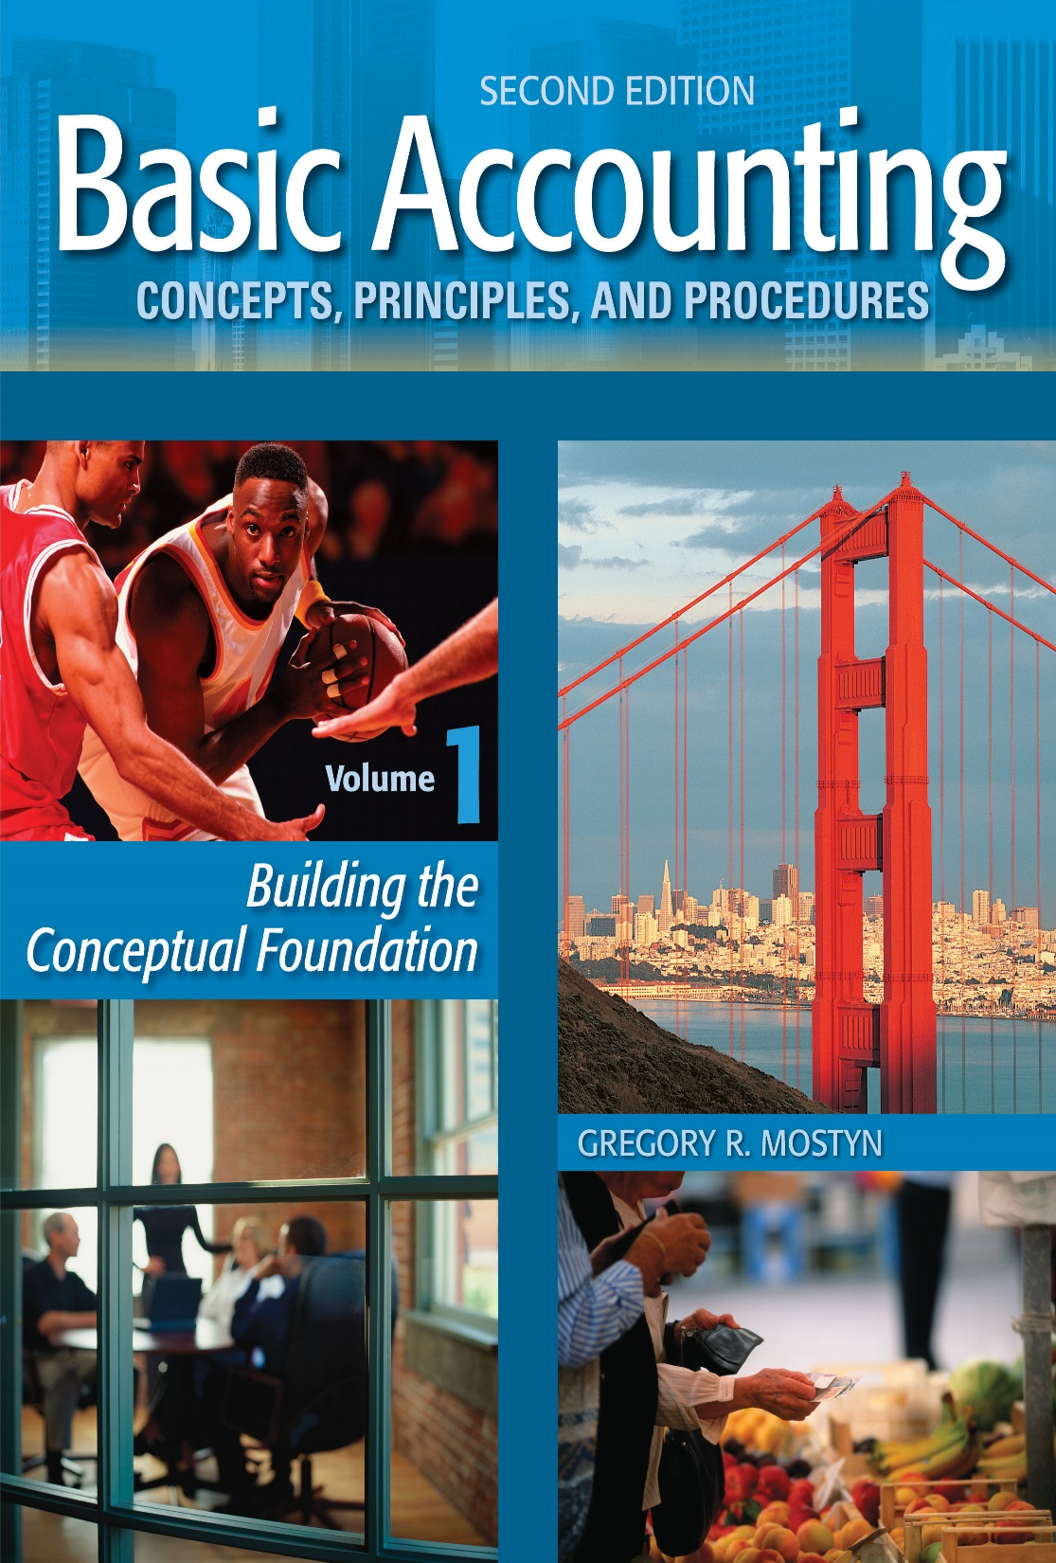
Basic Accounting Concepts Principles and Procedures, 2nd Edition, Volume 1
Basic Accounting Concepts Principles and Procedures, 2nd Edition, Volume 1

Slide 2
Enhanced Introduction Learning Goal 1

Slide 3
Accounting and Business
• Accounting has many applications and is essential for many types of organizations and activities. Accounting is used by these kinds of organizations:
Businesses
Government
Non-profits
Informal groups
• However, the most frequent application of accounting occurs in business. Our discussion of accounting will relate primarily to business activities.
• The following slides explain the essential features of a business.

Slide 4
Identify a Business
• A business is an organization or activity with the primary goal of accumulating
wealth for the owner(s) by creating valuable new resources and selling them to
customers.
• Two kinds of resources to sell: The two kinds of resources that can be created
and sold are property and services. These are sometimes called “goods and
services”.
• Property: Any resource that can be owned. Property usually, but not always,
has a dollar value. Examples are computers, cars, equipment, real estate, etc.
• Services: Services are the use of someone else’s labor or the use of someone
else’s property. Services usually, but not always, have a dollar value. Examples
are renting equipment or real estate, repair services, accounting services,
advertising, etc.

Slide 5
The Concept of Wealth
• As stated earlier, the primary purpose of a business is to create wealth for the business owner(s).
• For business purposes, wealth is the dollar value of property owned by a business. Because a quality of property is that it can be owned, wealth can be accumulated.
• Although many types of property are physically useful (like equipment) the idea
of wealth ignores this quality and refers only to dollar value.
Examples of business wealth:
• Money
• Equipment
• Supplies
• Account receivable (the legal right to collect from a customer)
Not wealth:
• Broken equipment that cannot be sold, because: it has no dollar value.
• Telephone services, because: services cannot be owned.

Slide 6
Businesses Classified by Resource
One way to classify a business is by the type of resource created.
• Service business: A service business creates services. Examples are repairs,
professional services, delivery, and entertainment.
• Merchandising business: A merchandising business buys merchandise from
suppliers and then offers a convenient selection of merchandise to customers.
Examples are grocery store, bookstore, stores in a mall, and car dealer.
• Manufacturing business: A manufacturing business creates new property.
Examples are computer and automobile manufactures, and farmers.
• Combination business: Sometimes a business combines resources created. This
occurs most frequently with service and merchandising businesses. For example,
a watch repair business may also sell watches and jewelry.

Slide 7
How a Businesses Creates Resources
• A business creates new resources by using up other resources and combining them to create something that is new and valuable, such as a service or product. A business primarily receives more wealth by selling to customers.
Use up resources
• Property
• Services
Create and sell
new resources
Receive wealth from customers
Obtain more resources
• The process of creating a valuable new resource and selling it to customers is called “adding value” or the “adding value process”.

Slide 8
Expenses
• In business, the term for using up a resource in operations for the adding value process is called an “expense”.
• The amount of an expense is the dollar value of the resource that was used up.
Examples:
Expense | Resource Used
$7,500 wages expense | Employee services
$2,000 rent expense | Building rental
$500 office supplies expense | Office supplies
$3,500 cost of goods sold | Merchandise sold to customers
Not expenses:
• $15,000 to pay a bank loan: Paying a debt is not part of the adding value process.
• $200 cash paid for supplies: One resource (cash) is given up for another resource (supplies).

Slide 9
The Amount of Value Created
• The total dollar value that a business creates is often called the “added value”.
• A business tries hard to create as much value as possible with as little resources as possible.
Examples:
Resource Created | The added value is... | and expenses incurred were...
$35 large pizza | $35 each | Wages, pizza ingredients, utilities, other business expenses
$50,000 automobile | $50,000 each | Wages, metal, plastic, electronics, utilities, insurance, other business expenses
$2,500 advertising services | $2,500 | Wages, Internet use, utilities, supplies, other business expenses.

Slide 10
The Amount of Value Created, continued
• Caution: Expenses do not always add value, even though they should.
• A business may operate inefficiently and incur expenses that add little or no
value. A business should try as hard as possible to eliminate non-value adding
expenses.
Examples:
• Significant storage costs because too many units were produced.
• Labor and materials required to repair manufacturing mistakes.
• Cost of hiring and training new employees because many dissatisfied employees
quit.

Slide 11
Determining the Amount of Added Value
• Added value is difficult to predict. The amount of added value cannot be
accurately known until the resource created is sold. This is because final
“value” is really in the minds of the potential customers.
Example #1: A publisher offers 5,000 books for sale for $25 each. Only 4,000 books are sold for $25. The publisher has to sell the remaining 1,000 books for $12 each.
Example #2: Another publisher also offers 5,000 books for sale for $25 each. At the same time, the publisher pays for a big advertising promotion. All the books immediately sell out for $25. The advertising has made the books more valuable in the minds of the potential customers.

Slide 12
Revenue
• In business, “revenue” is the word for how much a resource has sold for. “Revenue” means the dollar value of an actual sale.
• In effect, revenue is confirmation of added value.
Example #1: An accountant requires 35 hours to prepare financial statements. The accountant charges $95 per hour for this type of service. The total revenue (confirmed added value) for this job is $3,325.
Example #2: A grocery store receives 200 fresh organic avocados and sets the sales price at $1.50 each. 160 avocados are sold. After two days the merchant reduces the price because the avocados might spoil. The remaining 40 are sold for $.90 each. The total revenue (confirmed added value) is $276.00
Not revenue:
• Receiving money from a bank loan
• Receiving money from an investor or investing money in a business

Slide 13
Measuring Success or Failure
Success: Net income
• To be successful, a business must create net income
“Net income” means the excess of revenues above expenses. When a business has net income, it has received more value from sales to customers than the value that was used up for expenses.
Example: An advertising business sold 190 hours of advertising service this month at a rate of $50 per hour for total revenue of $9,500. Total expenses were $8,100. Net income for the month is: $9,500 – $8,100 = $1,400.
• To create net income, a business must:
• Create value (revenue), and
• the value created is greater than resources consumed to create the value.

Slide 14
Measuring Success or Failure, continued
Failure: Net loss
“Net loss” means the excess of expenses above revenues. When a business has a net loss, it has received less value from sales to customers (revenue) than the value that was used up for expenses.
Example: A restaurant sold meals and beverages for $20,000 for the month (the confirmed added value of revenue). Total expenses were $29,000. The result is
$20,000 – $29,000 = – $9,000 (net loss).
To correct this situation the business may need to:
• Use resources more efficiently or pay less for the resources.
• Use resources in a different way to create something more interesting
• Charge more for what is being created.

