Slide 1
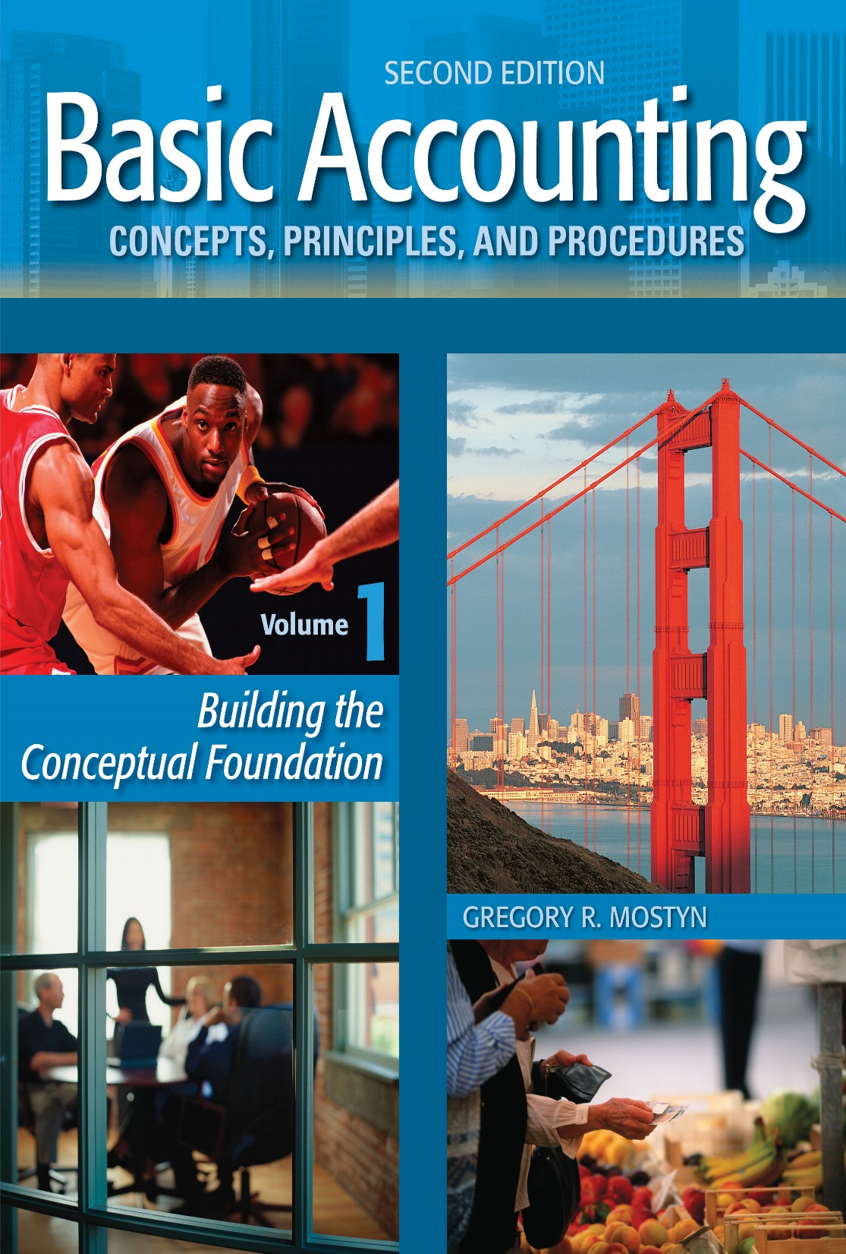
Basic Accounting Concepts Principles and Procedures, 2nd Edition, Volume 1
Basic Accounting Concepts Principles and Procedures, 2nd Edition, Volume 1

Slide 2
Learning Goal 11

Slide 3
Recording Transactions
• After transaction analysis, the next stage in the accounting process is recording transactions.
• This process is often called “bookkeeping”. Bookkeeping is important because it permanently records transaction data in a systematic way. This then becomes the source of financial reporting.
• The following table is the first step in learning a bookkeeping system.
• Bookkeeping system rules:
Increases: For any item on the left side of the accounting equation (assets), make a left-side entry. For any item on the right side of the accounting equation (liabilities and owner’s equity, make a right-side entry. Decreases: Simply do the opposite of increases.
© Copyright 2018 Worthy and James Publishing

Slide 4
On May 5, Ronald Flores deposited $8,000 in a bank account for his new business, ABC Computer Services
A
=
L + OE
8,000
8,000
Operational
Change
Cash
Capital
Increase
+
Decrease
-
Increase
+
Decrease
-
Increase
+
Decrease
-
Decrease
-
Increase
+
Decrease
-
Increase
+
Expense
Revenue
5/5
8,000
8,000

Slide 5
On May 9, the business paid $1,200 for supplies
A
=
L + OE
8,000
8,000
Operational
Change
Cash
Supplies
Capital
Increase
+
Decrease
-
Increase
+
Decrease
-
Increase
+
Decrease
-
Decrease
-
Increase
+
Decrease
-
Increase
+
Expense
Revenue
5/5
8,000
8,000
5/9
1,200
1,200
Balance
6,800

Slide 6
On May 11, the business purchased additional supplies on account for $1,500
=
A
L + OE
9,500
1,500
8,000
Accounts
Payable
Operational
Change
Cash
Supplies
Capital
Decrease
-
Decrease
-
Increase
+
Increase
+
Increase
+
Decrease
-
Increase
+
Decrease
-
Decrease
-
Increase
+
Decrease
-
Expense
Revenue
5/5
8,000
8,000
5/9
1,200
1,200
Balance
6,800
5/11
1,500
1,500
2,700

Slide 7
On May 14, The company completed a job and received $2,750 cash from a customer
=
A
L + OE
12,250
1,500
10,750
Accounts
Payable
Operational
Change
Cash
Supplies
Capital
Decrease
-
Decrease
-
Increase
+
Decrease
-
Decrease
-
Increase
+
Increase
+
Increase
+
Decrease
-
Decrease
-
Increase
+
Expense
Revenue
5/5
8,000
8,000
5/9
1,200
1,200
Balance
6,800
5/11
1,500
1,500
5/14
2,750
2,700
2,750
9,550

Slide 8
On May 17, The business determined that it had used up $300 of supplies
=
A
L + OE
11,950
1,500
10,450
Accounts
Payable
Operational
Change
Cash
Supplies
Capital
Decrease
-
Decrease
-
Increase
+
Increase
+
Decrease
-
Increase
+
Decrease
-
Increase
+
Decrease
-
Decrease
-
Increase
+
Expense
Revenue
5/5
8,000
8,000
5/9
1,200
1,200
Balance
6,800
5/11
1,500
1,500
5/14
2,750
2,700
2,750
9,550
5/17
300
300
2,400

Slide 9
On May 20, The business completed a $2,000 job for a customer. The customer paid $600 and will pay the balance on account
=
A
L + OE
13,950
1,500
12,450
Accounts
Receivable
Accounts
Payable
Operational
Change
Cash
Supplies
Capital
Decrease
-
Decrease
-
Decrease
-
Decrease
-
Increase
+
Increase
+
Increase
+
Increase
+
Decrease
-
Increase
+
Decrease
-
Expense
Revenue
5/5
8,000
8,000
5/9
1,200
1,200
Balance
6,800
5/11
1,500
1,500
5/14
2,750
2,700
2,750
9,550
5/17
300
300
5/20
600
1,400
2,400
2,000
10,150

Slide 10
On May 23, The business wrote checks for $2,100. $900 was payment for Accounts Payable and $1,200 was for the month’s rent expense.
=
A
L + OE
11,850
600
11,250
Accounts
Receivable
Accounts
Payable
Operational
Change
Cash
Supplies
Capital
Decrease
-
Increase
+
Increase
+
Decrease
-
Increase
+
Increase
+
Decrease
-
Decrease
-
Decrease
-
Increase
+
Decrease
-
Expense
-
Revenue
+
5/5
8,000
8,000
5/9
1,200
1,200
Balance
6,800
5/11
1,500
1,500
5/14
2,750
2,700
2,750
9,550
5/17
300
300
5/20
600
1,400
2,400
2,000
10,150
5/23
2,100
900
1,200
8,050

Slide 11
On May 26, The company received a $1,000 bill for advertising, which was not paid immediately.
=
A
L + OE
11,850
1,600
10,250
Accounts
Receivable
Accounts
Payable
Operational
Change
Cash
Supplies
Capital
Decrease
-
Decrease
-
Increase
+
Increase
+
Decrease
-
Increase
+
Decrease
-
Increase
+
Decrease
-
Decrease
-
Increase
+
Expense
-
Revenue
+
5/5
8,000
8,000
5/9
1,200
1,200
Balance
6,800
5/11
1,500
1,500
5/14
2,750
2,700
2,750
9,550
5/17
300
300
5/20
600
1,400
2,400
2,000
10,150
5/23
2,100
900
1,200
8,050
600
5/26
1,000
1,000
1,600

Slide 12
On May 31, The owner withdrew $500 cash from the business for personal use.
=
A
L + OE
11,350
1,600
9,750
Accounts
Receivable
Accounts
Payable
Operational
Change
Cash
Supplies
Capital
Decrease
-
Increase
+
Increase
+
Decrease
-
Increase
+
Decrease
-
Increase
+
Decrease
-
Decrease
-
Increase
+
Decrease
-
Expense
-
Revenue
+
5/5
8,000
8,000
5/9
1,200
1,200
Balance
6,800
5/11
1,500
1,500
5/14
2,750
2,700
2,750
9,550
5/17
300
300
5/20
600
1,400
2,400
2,000
10,150
5/23
2,100
900
1,200
8,050
600
5/26
1,000
1,000
5/31
500
1,600
500
7,550
7,500

Slide 13
On May 31, The business received a $200 payment from Accounts Receivable.
=
A
L + OE
11,350
1,600
9,750
Accounts
Receivable
Accounts
Payable
Operational
Change
Cash
Supplies
Capital
Decrease
-
Increase
+
Expense
-
Increase
+
Decrease
-
Increase
+
Decrease
-
Increase
+
Decrease
-
Decrease
-
Increase
+
Decrease
-
Revenue
+
5/5
8,000
8,000
5/9
1,200
1,200
Balance
6,800
5/11
1,500
1,500
5/14
2,750
2,700
2,750
9,550
5/17
300
300
5/20
600
1,400
2,000
10,150
5/23
2,100
900
1,200
8,050
600
5/26
1,000
1,000
5/31
500
500
7,550
5/31
200
200
7,750
1,200
2,400
1,600
7,500
2,500
4,750

