Slide 1
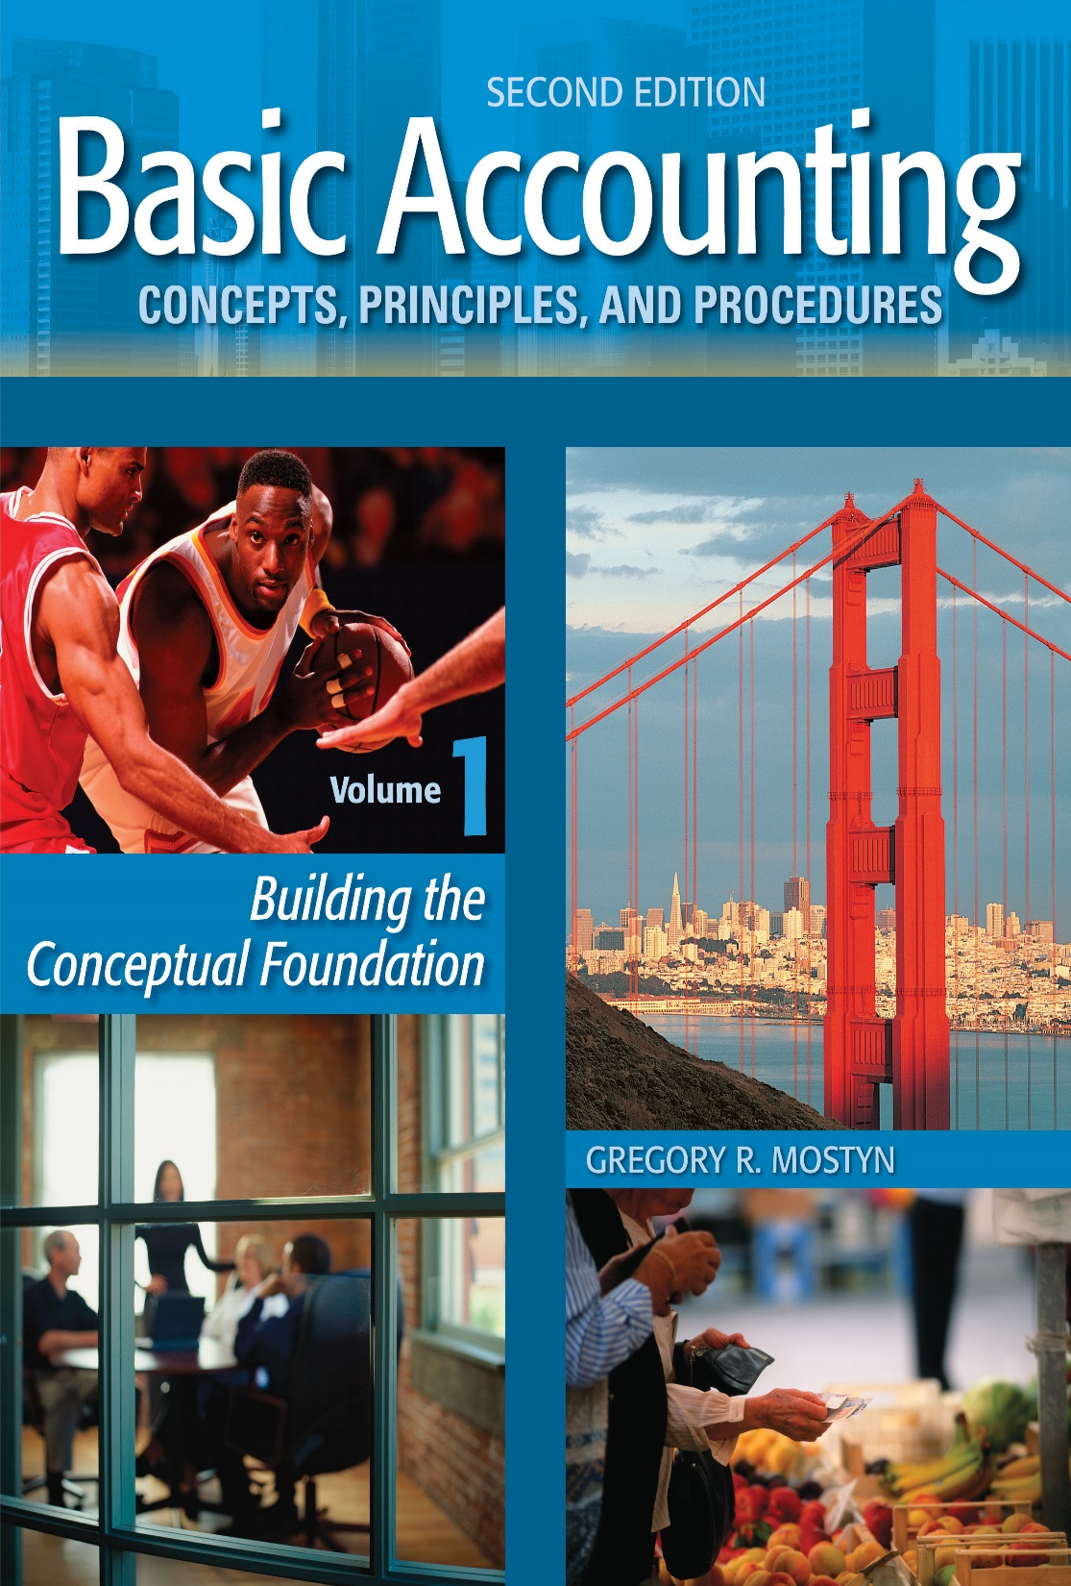
Basic Accounting Concepts Principles and Procedures, 2nd Edition, Volume 1
Basic Accounting Concepts Principles and Procedures, 2nd Edition, Volume 1

Slide 2
Learning Goal 27

Slide 3
The Accounting Cycle
The term accounting cycle refers to the recurring, sequential accounting activities
needed to record transactions, properly maintain accounting records, and ultimately
prepare financial statements.
• The main elements of the cycle that you have studied so far are:
* Analyzing events
* Processing transactions
• Journalizing
• Posting
• Trial balance
* Preparing financial statements

Slide 4
The Accounting Cycle
An illustration of the accounting cycle to this point is presented below.
1
Analyze event
Does it affect financial condition?
A “transaction”
Documents
Process
2
Journalize
5
Communicate *
* If trial balance amounts are correct
3
Post to ledger
Income statement
Statement of owner's equity
Balance sheet
Statement of cash flows
4
Trial Balance
Completion of Cycle
(Volume 2)

Slide 5
The Accounting Cycle
Completing the cycle
You probably noticed from the illustration that the accounting cycle is not quite complete at this point, and there are remaining steps in Volume 2. What remains to be done?
• Adjustments: Due to the passage of time or other events, some account balances often need to be adjusted because they are out of date.
• Corrections: Sometimes balances are incorrect and need to be corrected.
• Closing: A process called “closing the books” needs to be completed.

