Slide 1
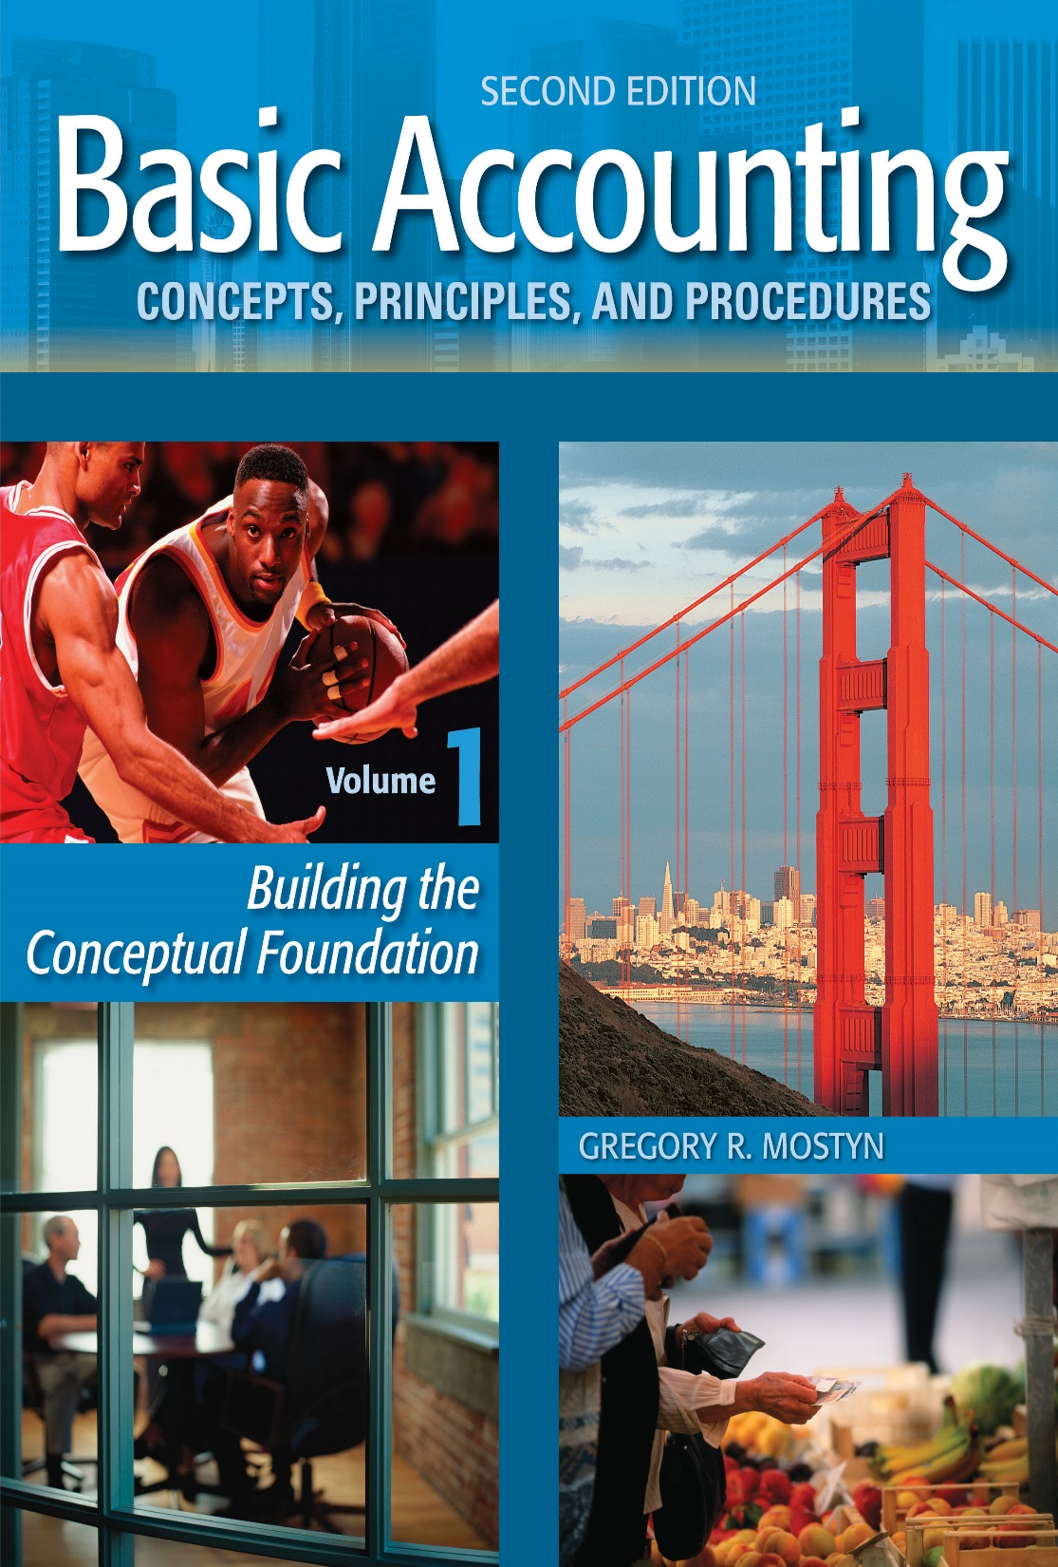
Basic Accounting Concepts Principles and Procedures, 2nd Edition, Volume 1
Basic Accounting Concepts Principles and Procedures, 2nd Edition, Volume 1

Slide 2
Learning Goal 28

Slide 3
What Is A Corporation?
A corporation is an entity created by law that has the following features:
• It is separate legal person, separate and distinct from its owners.
• The owners are called “stockholders” or “shareholders” and generally do not have personal liability for the acts of the corporation.
• Ownership is divided into units, called shares of stock. In a corporate business, these shares are purchased by the shareholders (stockholders).
Transferability: Shares can freely be bought, sold, and transferred without the approval of other shareholders (unlike a partnership).
• No “mutual agency” :The acts of any shareholder are not binding on other shareholders.
• Continuous life: The life of a corporation is usually perpetual. Changes in ownership normally have no effect on the life of a corporation.
• Double taxation: A corporation pays tax as a separate legal “person”. Also the shareholders of a corporation pay tax on distributions from a corporation, called “dividends”.

Slide 4
The Corporate People
Incorporator: The person who chooses a corporate name and completes the application
process to create a corporation.
• Stockholders (shareholders): The owners of a corporation.
• Board of directors: Individuals elected by the shareholders to represent them, to safeguard
their interests in the company, and to supervise the management. Directors can be
independent or can be company officers or employees; however, independent is preferable.
• Chief executive officer (CEO): The highest level company officer. A CEO is responsible for
strategic planning and the supervision of other officers. Sometimes a CEO sits on the
board of directors as chairman of the board.
• Chief financial officer (CFO): The officer responsible for all financial matters including
financial reporting.
• Securities and Exchange Commission (SEC): An independent federal government agency
that regulates corporations that issue publicly-owned stock. The SEC regulates the
creation of corporations, obtaining investments, and the quality of financial reporting.

Slide 5
How a Corporation Is Created
A corporation is incorporated (created) in only one state, even if it operates in many states.
1) The incorporator completes an application for the state regulatory agency.
2) The application contains the “Articles of Incorporation”, which identifies the name, location, general purpose, and a request for a specified number and type of shares of stock. Other information is also provided, such as names of incorporator, initial board of directors, and corporate agents. This is public information.
3) If the application is approved the company receives a “Charter” from the state. A charter officially creates the corporation and authorizes a specified number and type of shares.
4) The incorporator and initial board of directors create the “Bylaws”. Bylaws are the detailed rules that govern the operation and procedures of a corporation, such as meetings procedures, required notices, appointment and removal of officers, and stockholder voting rights and procedures. Bylaws are not usually public documents.
5) The initial meeting of the board of directors decides on the number of shares of stock to sell and sales price per share.
6) After the initial stock sale, at the first stockholder meeting, the shareholders vote on a new board of directors and confirm officers appointed by the Board.

Slide 6
Basic Classification
For-profit on non-profit: The purpose of a for-profit corporation is to make a profit and create wealth for shareholders. A non-profit corporation is created for charitable or educational purposes, and does not issue shares.
• Publicly-held or privately-held: When a corporation offers and sells shares to the general public, it is called a publicly-held corporation. A corporation that does not do this is called a privately-held corporation. A privately-held corporation may have just a few or one stockholder.
• Limited liability company (LLC): A limited liability company has features of both a
partnership and corporation. Articles of organization must be approved by the state in
which it is created.

Slide 7
Corporation Advantages and Disadvantages
Advantages | Disadvantages
• Potentially can obtain much more investment capital than a proprietorship or partnership. | • Corporate management sometimes not responsive to shareholders or best interests of the company
• No personal owner liability | • Double taxation
• Ease of transfer of investment | • Increased costs of reporting and regulation
• Professional management
• Continuous life

Slide 8
Issuing Stock
Direct issuance: A corporation promotes and sells its stock directly to the public.
Indirect issuance: More common than direct issuance. A corporation uses the services of a
specialized company or division of a bank that promotes the stock and sells it to the public.
This kind of company is called a stock “underwriter”. Banks that perform this service are
called “investment banks”.
Initial public offering (IPO): The first time that a company sells its stock to the public is
called an “Initial public offering”.
Secondary offering: If a corporation later sells more stock after the initial public offering,
this later sale is called a “secondary offering”.

Slide 9
Market Value of Stock
At the time of an IPO, an underwriter makes an estimate of the best price to offer the stock, and the initial investors purchase the stock at this price or near this price.
• After the IPO, when a stock trades on a public exchange such as the New York Stock Exchange, the actual price of what a stock sells for is constantly changing between buyers are sellers. This involves two prices.
• Asking (offer) price: This is the price that a seller is asking.
• Bid price: This is the price that a buyer wants to pay
• Spread: The difference between the asking and bid prices. Actual sales price is often somewhere between ask and bid.
• When a stock is bought and sold after the IPO, the financial transactions are only between investor buyers and sellers. There is no direct effect on the company issuing the shares.

Slide 10
Authorized and Issued Shares
Authorized shares: These are the total number of shares authorized by the corporate
charter from the state. These are the maximum number shares that can be sold unless the
corporation applies to the state for additional shares. This incurs additional expense and
usually requires shareholder approval.
• Issued shares: These are the number of shares that have been sold to investors or issued
for other reasons, such as employee stock. When shares of stock are issued, accounting
entries are usually required. These transactions are discussed in the next learning goals.

