Slide 1
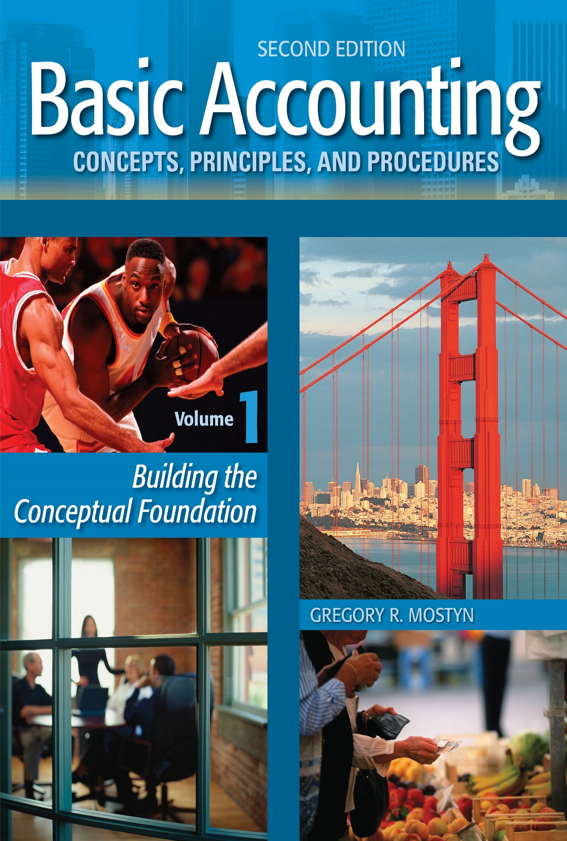
Basic Accounting Concepts Principles and Procedures, 2nd Edition, Volume 1
Basic Accounting Concepts Principles and Procedures, 2nd Edition, Volume 1

Slide 2
Learning Goal 31

Slide 3
Corporations: Balance Sheet
• The key difference between a corporate balance sheet and other balance sheets is stockholders' equity. We have extensively discussed stockholders' equity in prior learning goals. In this learning goal we add one final element.
• Here is an overview of the four main parts of stockholders' equity:
 | ABC, Inc. Balance Sheet (partial) June 30, 20xx Stockholders’ equity
 | Paid-in capital
 | xxx... |  |  | $$
 | xxx... |  |  | $$
 | Retained earnings |  |  | $$
 | Less: Treasury stock |  |  | ($$)
 | Accumulated other comprehensive income |  |  | $$
• The final item for our discussion is “accumulated other comprehensive income”. This results from value changes in specified assets and liabilities, most often from “unrealized” gains and losses.
We will discuss comprehensive income after reviewing gains and losses next.

Slide 4
Gains and Losses
• A “gain” is similar to revenue, and has the same effect on net income. However, a gain is something that is incidental to being in business. It is not part of the central activities or operations. It is not revenue. Example: selling unneeded supplies or equipment for more than they cost.
• A “loss” is similar to an expense, and has the same effect on net income. However, a loss is something that is incidental to being in business. It is not part of the central activities or operations. It is not an expense. Example: selling unneeded supplies or equipment for less than they cost.

Slide 5
Unrealized Gains and Losses
• “Unrealized” means not yet actually sold. “Realized” means sold and proceeds collected.
• Example: Unrealized gain. ABC Company has invested in certain securities (stocks and bonds) that cost $15,000. Today the securities have increased in value, and they would sell for $19,000. There is an unrealized gain of $4,000. The securities have not yet been sold, so the gain is only a potential: It is unrealized.
• Example: Unrealized loss. XYZ Company has invested in land that cost $40,000. The value of the land today is $25,000. There is an unrealized loss of $15,000. The land has not yet been sold, so the loss is only a potential: It is unrealized.

Slide 6
Comprehensive Income
“Comprehensive income” is net income (or loss) combined with value changes in specified assets and liabilities. These value changes are called “other comprehensive income”.
The idea is that comprehensive income is an amount that includes all changes in stockholders' equity resulting from net income plus designated asset or liability value changes that would not otherwise be included in net income.
Comprehensive income does not include stockholders’ equity transactions between a company and stockholders, such as selling stock, dividends, and treasury stock.

Slide 7
Other Comprehensive Income
“Other comprehensive income” is the current period value changes in certain specified assets and liabilities. These value changes represent unrealized gains and losses. Because they are unrealized, the value changes are not included as part of net income, but they should still be disclosed.
The most common value changes come from certain investments in securities,
foreign currency transactions, and pension plan investments.

Slide 8
Reporting Comprehensive Income Elements
Step | Action
1 | Other comprehensive income: Identify the specified item value changes in the current accounting period. These are assets or liabilities with balances that are changed because of value changes that are not reported in the income statement. The net change is called other comprehensive income. Other comprehensive income will be combined with net income in step 2.
2 | Comprehensive income: Report other comprehensive under net income and combine the two. The result is called comprehensive income.
3 | Accumulated other comprehensive income: Combine other comprehensive income (current period) with accumulated other comprehensive income from past periods to determine the current balance of accumulated other comprehensive income. Report the result in stockholders’ equity.

Slide 9
Reporting Comprehensive Income
Example: The illustration below shows the reporting of comprehensive income below the income statement
in a separate statement.
 | Xxx................................................... |  |  |  | $$
 | Xxx ....................................................... |  |  |  | $$
 | Net income........................................ |  |  |  | $50,000
 | DEF, Inc. Statement of Comprehensive Income For the Year Ended September 30, 20xx
 | Net income......................................... |  |  |  | $50,000
 | Other comprehensive income: unrealized gain on certain securities net of $5,000 income tax... |  |  |  | 15,000
 | Comprehensive income....................... |  |  |  | $65,000

Slide 10
Reporting Accumulated Other Comprehensive Income
As previously indicated, the balance of accumulated other comprehensive income is shown in stockholders' equity. Assume that the prior period ending balance was $12,000.
 | DEF, Inc. Balance Sheet (partial) September 30, 20xx Stockholders’ equity
 | Paid-in capital
 | xxx... |  | $$
 | xxx... |  | $$
 | Retained earnings |  | $$
 | Less: Treasury stock |  | ($$)
 | Add: accumulated other comprehensive income |  | 27,000
 | Total stockholders' equity |  | $$

Slide 11
Statement of Stockholders' Equity
• A company is required to report the changes in stockholders’ equity.
• If the only changes are those that affect retained earnings, then a company will prepare a
statement of retained earnings.
• If there are more changes to stockholders' equity beyond retained earnings (such as selling
stock, treasury stock transactions, accumulated other comprehensive income) then a
company also must disclose those other changes. In this case, most companies prepare a
statement called a “statement of stockholders' equity” that shows all changes.
• When a statement of stockholders' equity is prepared, a statement of retained earnings is
not necessary, because that information is contained in a statement of stockholders' equity.

Slide 12
Statement of Stockholders' Equity, continued
Example: A table is prepared, with columns that are for each item in stockholders' equity. Ending balance in each column corresponds to the final balance of the item in the stockholders' equity section of the balance sheet.
 | Common Stock $1 Par Value | Additional Paid-in Capital | Retained Earnings | Treasury Stock | Total
Beg. Balance
End. Balance

Slide 13
Statement of Stockholders' Equity, continued
Example: Assume the beginning balances as shown. During the year the company:
1) Earned $70,000 of net income, 2) Sold 50,000 shares of common stock for $12 per share, and 3) Purchased 5,000 shares of treasury stock for $9 per share.
 | Common Stock $.01 Par Value | Additional Paid-in Capital | Retained Earnings | Treasury Stock | Total
Beg. Balance | $2,000 | $2, 240,000 | $190,000 | -0- | $2,432,000
Net income |  |  | 70,000 |  | 70,000
Stock sale | 500 | 599,500 |  |  | 600,000
Treas. stock purchase |  |  |  | (45,000)
End. Balance | $2,500 | $2,839,500 | $260,000 | $(45,000) | $3,057,000
(45,000)
Questions: In the same period, how would the table change if...
• There had been a $10,000 cash dividend?
• 1,000 shares of the treasury stock were sold for $10 per share?

Slide 14
The Income Statement of a Corporation
• An income statement of a corporation follows the same basic idea as a proprietorship
income statement, showing revenues and expenses.
• However, a corporate income statement contains more elements and therefore can be more complex.
• The following illustrations show a multiple-step corporate income statement. We will
build the statement one part at a time.

Slide 15
The Income Statement of a Corporation, continued
• The first element of the income statement is operating income.
• Operating income is revenue minus operating expenses. Often operating expense details
are presented on a separate page, as you see indicated here.
San Jose Consulting Services Income statement For the Year Ended December 31, 20xx
 | Service revenue...................................................... |  |  |  | $1,850,000
 | Operating expenses (see detail)............................. |  |  |  | 1,110,000
 | Operating income .................................................. |  |  |  | 740,000

Slide 16
The Income Statement of a Corporation, continued
• The next section of the income statement is “other” items. These are items that affect income but are not part of main operations of the business.
• Losses that are unusual and infrequent such as the fire, flood, earthquake, etc. are also part of “other” items. They should be clearly identified by type of loss.
• This part of the income statement is important because it shows the income or loss from all activity before any tax.
San Jose Consulting Services Income statement For the Year Ended December 31, 20xx
 | Service revenue..................................................... |  |  |  | $1,850,000
 | Operating expenses (see detail)........................... |  |  |  | 1,110,000
 | Operating income ................................................. |  |  |  | 740,000
 | Other revenue, expense, gain or loss.................
 | Interest income.............................................. |  |  | $2,700
Loss on equipment sale...................................
Rental revenue................................................ |  |  |  | 12,000
 | Fire loss.........................................................
 | Income before tax............................................. |  |  |  | 724,200
(4,500)
(26,000)
(15,800)

Slide 17
The Income Statement of a Corporation, continued
• The next section of the income statement shows the income tax expense and the remaining income after tax. This is called “net income”.
San Jose Consulting Services Income statement For the Year Ended December 31, 20xx
 | Service revenue........................................................ |  |  |  | $1,850,000
 | Operating expenses (see detail)............................... |  |  |  | 1,110,000
 | Operating income .................................................... |  |  |  | 740,000
 | Other revenue, expense, gain or loss.......................
 | Interest income..................................................... |  |  | $2,700
Loss on equipment sale..........................................
Rental revenue....................................................... |  |  |  | 12,000
 | Fire loss.................................................................
 | Income before tax……............................................... |  |  |  | 724,200
 | Income tax expense.............................................. |  |  |  | 220,000
 | Net income........................................................... |  |  |  | $504,200
(4,500)
(26,000)
(15,800)

Slide 18
Discontinued Operations
• Sometimes a business will dispose of a major, separate, component of its business. Such a component would be a clearly identifiable operation different
from the rest of the business.
• This is a special item that GAAP requires to be disclosed separately at the bottom of an income statement. The disclosure consists
of two parts: 1) Income or loss up to date of disposal, 2) Gain or loss on the disposal. These must also show income tax effect.
San Jose Consulting Services Income statement For the Year Ended December 31, 20xx
 | Service revenue....................................................... |  |  |  | $1,850,000
 | Operating expenses (see detail).............................. |  |  |  | 1,110,000
 | Operating income ................................................... |  |  |  | 740,000
 | Other revenue, expense, gain or loss......................
 | Interest income.................................................... |  |  | $2,700
Loss on equipment sale........................................
Rental revenue...................................................... |  |  |  | 12,000
 | Fire loss................................................................
 | Income from continuing operations before tax…... |  |  |  | 724,200
 | Income tax expense................................................. |  |  |  | 220,000
 | Income from continuing operations....................... |  |  |  | 504,200
 | Discontinued operations
 | Income from internet hosting operations of
 | $50,000 less income tax of $14,000.................. |  |  | 36,000
 | Loss on disposal of $100,000 less tax savings
 | of $21,000........................................................
 | Net income.............................................................. |  |  |  | $461,200
(4,500)
(26,000)
(15,800)
(79,000)
(43,000)

Slide 19
Discontinued Operations
• Notice the name changes created by the discontinued operations
San Jose Consulting Services Income statement For the Year Ended December 31, 20xx
 | Service revenue........................................................ |  |  |  | $1,850,000
 | Operating expenses (see detail)............................... |  |  |  | 1,110,000
 | Operating income .................................................... |  |  |  | 740,000
 | Other revenue, expense, gain or loss.......................
 | Interest income..................................................... |  |  | $2,700
Loss on equipment sale.........................................
Rental revenue....................................................... |  |  |  | 12,000
 | Fire loss.................................................................
 | Income from continuing operations before tax……. |  |  |  | 724,200
 | Income tax expense.................................................. |  |  |  | 220,000
 | Income from continuing operations........................ |  |  |  | 504,200
 | Discontinued operations
 | Income from internet hosting operations of
 | $50,000 less income tax of $14,000..................... |  |  | 36,000
 | Loss on disposal of $100,000 less tax savings
 | of $21,000.............................................................
 | Net income............................................................... |  |  |  | $461,200
(4,500)
(26,000)
(15,800)
(79,000)
(43,000)
Reminder: If there had been other comprehensive income items, then the comprehensive income presentation would be below this statement.

Slide 20
A Merchandising Company Income Statement
• Companies that sell merchandise such as retail stores or manufacturing companies have an additional large expense. This is called “cost of goods sold”, which is the cost of the merchandise they sell.
ª Cost of goods sold is a separate line item under sales.
• When cost of goods is subtracted the result is called “gross profit”.

Slide 21
A Merchandising Company Income Statement, continued
• Assume that the company is a merchandising company called San Jose Sales Company.
• Notice the addition of cost of goods sold and gross profit.
San Jose Sales Company Income statement For the Year Ended December 31, 20xx
 | Sales revenue.......................................................... |  |  |  | $1,850,000
 | Cost of goods sold............................................... |  |  |  | 940,000
 | Gross profit......................................................... |  |  |  | 910,000
 | Operating expenses (see detail)............................. |  |  |  | 500,000
 | Operating income ................................................... |  |  |  | 410,000
 | Other revenue, expense, gain or loss......................
 | Interest income.................................................... |  |  | $600
Gain on equipment sale........................................ |  |  |  | 2,000 | 2,600
 | Income before tax................................................... |  |  |  | 412,600
 | Income tax expense................................................ |  |  |  | 90,000
 | Net income.............................................................. |  |  |  | $322,600

Slide 22
Earnings Per Share (EPS)
• Earnings per share is a calculation that shows the amount of income per share of common
stock outstanding. EPS is a very useful number for two reasons:
1) It clarifies the income comparison of different size companies. For example,
If Big Company has net income of $1,000,000 and 500,000 shares
outstanding, its EPS is $2.
If Small Company only has income of $400,000 and100,000 shares outstanding, its EPS
is $4. Even though Small Company has less total income, individual stockholders have
a greater claim on income.
2) EPS is used as part of a very common stock analysis calculation called the price-
earnings ratio (PE ratio). The calculation compares stock price to earnings. It is
calculated as: stock price per share/ earnings per share. Earnings have a powerful effect
on stock price.

Slide 23
Calculation of Basic Earnings Per Share (EPS)
• The basic EPS calculation for net income is: $\frac{(Net Income−Preferred Dividends)}{Weighted Average Shares Outstanding}$
• Example: Mayberry Corporation has $220,000 of net income and $500,000 par value, 4%
preferred stock outstanding. Its average number of common shares outstanding for the
period is 160,000 shares.
[$220,000 – ( $500,000 x .04)] / 160,000 = $1.25 EPS
Note: If there are dividends in arrears on cumulative preferred, they should be included.
• A second type of EPS may also need to be calculated for certain situations or complex
capital structures. It is called “diluted EPS”. It is used to show hypothetical EPS if
treasury stock were sold or certain types of securities were converted to common stock.

Slide 24
Calculation of Basic Earnings Per Share (EPS), continued
• A weighted average is a calculation that multiplies each number used in the average by a
value. These values are the “weights” in the weighted average, and change the amount of
the average.
• In the weighted average for EPS, the weights that are used are the time periods that
the amounts of shares are outstanding.
Example:
At January 1, the beginning of the annual accounting period, San Jose Consulting Services had 200,000 shares of common stock outstanding. On June 1 it issued another 70,000 shares. On November 30, it purchased 50,000
shares for treasury stock.
Date | Shares Outstanding | Months | Weighted Total
Jan. 1 | 200,000 | 5 | 1,000,000
June 1 | 270,000 | 6 | 1,620,000
Nov. 30 | 220,000 | 1 | 220,000
Total |  | 12 | 2,840,000
2,840,000 / 12 = 236,667 weighted average number of shares.

Slide 25
Presentation of Basic Earnings Per Share (EPS)
• Earnings per share is presented at the bottom of an income statement, under net income,
or under comprehensive income if that applies.
• Earnings per share is calculated for these numbers: continuing operations, discontinued
operations, and net income.
• Remember that if there is no discontinued operations special item, earnings per share will
only be needed for net income.
Example on next slide: Assume that annual preferred dividends for San Jose Corporation are $100,000. Use the weighted average number of shares of 236,667 from the previous slide.

Slide 26
Presentation of Basic Earnings Per Share (EPS), continued
San Jose Consulting Services Income statement For the Year Ended December 31, 20xx
 | Service revenue........................................................ |  |  |  |  | $1,850,000
 | Operating expenses (see detail)............................... |  |  |  |  | 1,110,000
 | Operating income .................................................... |  |  |  |  | 740,000
 | Other revenue, expense, gain or loss.......................
 | Interest income..................................................... |  |  |  | $2,700
Loss on equipment sale.......................................... |  |  |  |  | (4,500)
Rental revenue........................................................ |  |  |  |  | 12,000
 | Fire loss................................................................. | Fire loss................................................................. |  |  | (26,000)
 | Income from continuing operations before tax....... | Income from continuing operations before tax....... |  |  |  | 724,200
 | Income tax expense.................................................. | Income tax expense.................................................. |  |  |  | 220,000
 | Income from continuing operations......................... | Income from continuing operations......................... |  |  |  | 504,200
 | Discontinued operations | Discontinued operations
 | Income from internet hosting operations of | Income from internet hosting operations of
 | $60,000 less income tax of $14,000..................... | $50,000 less income tax of $14,000..................... |  |  | 36,000
 | Loss on disposal of $100,000 less tax savings | Loss on disposal of $100,000 less tax savings
 | of $21,000............................................................. | of $21,000.............................................................
 | Net income............................................................... | Net income............................................................... |  |  |  | $461,200
 | Earnings per share of common stock: | Earnings per share of common stock:
 | Income from continuing operations......................... | Income from continuing operations......................... |  |  |  | $1.71
 | Discontinued operations.......................................... | Discontinued operations..........................................
 | Net income................................................................ | Net income................................................................ |  |  |  | $1.53
(15,800)
(79,000)
(43,000)
$1.71
(.18)
• ($504,200 – $100,000)/236,667 = $1.708 • ($43,000)/236,667 = ($.182)
• ($461,200 – $100,000)/236,667 = $1.526

Slide 27
Book Value
• “Book value” is another term for stockholders' equity; however, when there is preferred stock, it generally refers to common stockholders’ equity claim in liquidation. *
• If there is preferred stock, book value is typically calculated as stockholders' equity minus the call price or par value of preferred stock plus any dividends in arrears.
Example:
 | Stockholders' Equity
 | Paid-in capital
 | Preferred stock, $50 par, 5%, 8,000 shares issued.......................................................... |  |  | $400,000
 | Paid-in capital in excess of par, preferred..... |  |  | 20,000 | $ 420,000
 | Common stock $.01 par value, 100,000 shares issued............................................... |  |  | 1,000
 | Paid-in capital in excess of par, common...... |  |  | 855,000 | 856,000
 | Total paid-in capital.................................. |  |  |  | 1,276,000
 | Retained earnings............................................. |  |  |  | 1,812,500
 | Total stockholders' equity......................... |  |  |  | $3,088,500
• Book value: $3,088,500 – ($50 X 8,000) = $2,688,500
• Book value per share: $2,688,500/100,00 shares outstanding (no treasury stock) = $26.885
*Book value also has a completely different meaning that refers to the undepreciated cost of a long-term asset.

