Slide 1
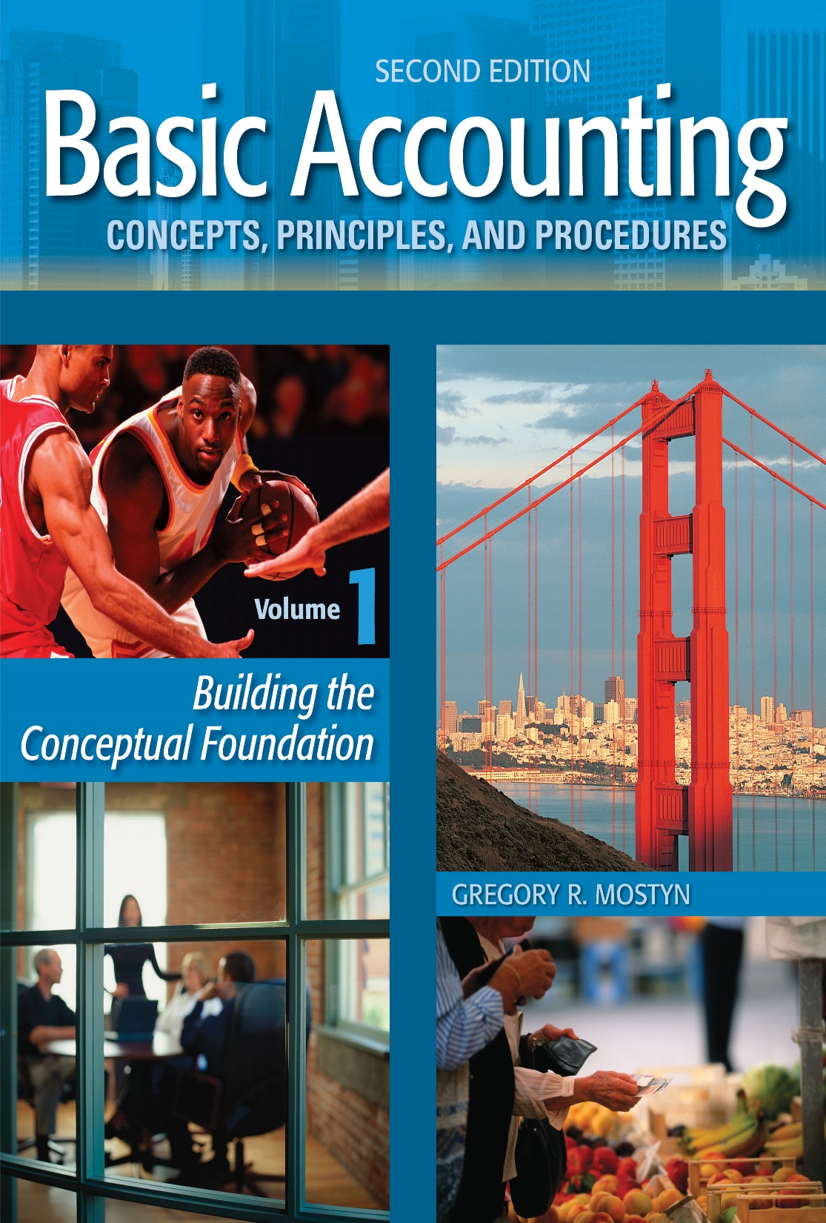
Basic Accounting Concepts Principles and Procedures, 2nd Edition, Volume 1
Basic Accounting Concepts Principles and Procedures, 2nd Edition, Volume 1

Slide 2
Enhanced Introduction Learning Goal 5

Slide 3
Economic Entities
• Definition: An economic entity is any activity for which financial condition or financial information needs to be reported separately.
Examples:
• A school is an economic entity
• A small business is an economic entity and its owner is a separate economic entity.
• A charity is an economic entity
• A large company is an economic entity. The divisions within the company are economic entities. Each department that reports financial activity is an economic entity.
• Why Does It Matter? If an economic entity is not identified, accounting for that entity (activity) is not possible. This is because activities will become mixed up with other entities and activities and not possible to trace.
Example: John owns two ice cream stores. He keeps only one set of records for both stores. He buys various types of ice cream and toppings and sells them in both stores. John will not know the net income or net loss from either store.

Slide 4
Economic Entity vs. Legal Entity
• “Economic entity” refers to an activity that must maintain separate record
keeping in order to identify the financial results of the activity.
• “Legal entity” refers to the legal rights and responsibilities of a person or
organization.
• Sometimes one activity may be separate or both.
Example: A proprietorship is a separate economic entity for the purpose of determining financial results. However, the legal rights and responsibilities of proprietorship activities are those of the owner – there is no distinction. For example, the owner of a proprietorship is also the legal owner of proprietorship assets. The owner is also personally responsible for debts and contract agreements.
Example: A corporation is a both a separate economic and legal entity. In addition to the need for separate record keeping, a corporation is a separate legal “person” created by law.

Slide 5
How Businesses Are Owned
• The common types of business ownership are:
• Proprietorship
• Partnership
• Corporation
• Limited liability company
• Each of these ownership types has certain advantages and disadvantages.

Slide 6
Proprietorships
• Definition: A proprietorship is a business that is owned by one person, and that is
not a corporation or other limited liability organization.
• Key features: The table below is an overview of key features of a proprietorship.
Feature | Description
Number of owners | One owner, who manages the business.
Difficult to start? | Easiest to start. Only a limited investment and very limited documentation is required (business license, resale certificate for a merchant, etc.)
Type of business | Any type of business can be a proprietorship, but the most common types are small service businesses and small merchandising companies.
Owner personal liability for business debts | The owner has personal liability for business debts; personal assets are at risk.
Taxation | Payments to the owner are withdrawals and not business expenses, and not taxed to the owner. Entire business net income or net loss is included in owner’s personal tax reporting.
Main advantages | • Easy to start • One person controls the business • Simplest record-keeping
Main disadvantages | • Personal liability • Limited resources

Slide 7
Partnerships
• Definition: A partnership is a business that is owned by more than one person, acting together as partners.
• Key features: The table below is an overview of key features of a partnership.
Feature | Description
Number of owners | Two or more owners, at least one who manages the business.
Difficult to start? | Technically easy to start – verbally agree and simply act as partners. Practically, a written detailed partnership agreement is needed to reduce conflict and allow planning. A business attorney should be used.
Type of business | Any type of business can be a partnership, but the most common types are service businesses and merchandising companies.
Owner personal liability for business debts | In a general partnership (see below) all partners have personal liability for all business debts; personal assets are at risk.
Taxation | Payments to partners are withdrawals and not business expenses, and not taxed to partners. Each partner’s share of net income or net loss is included in the partner’s personal tax reporting.
Main advantages | • Greater resources than a proprietorship • Great flexibility in allocating income and loss items.
Main disadvantages | • Personal liability • Potential for partner conflict • More complex record-keeping than a proprietorship • Requires time to carefully plan partnership agreement

Slide 8
Partnerships, continued
• There are varieties of partnership types, as briefly summarized below.
• General partnership: A partnership in which all partners have management
authority and can act on behalf of the partnership. Each partner has personal
liability for all partnership debts.
• Limited partnership: Partners are designated as general and limited partners.
Limited partners are at risk for only the amount invested, but do not have
management authority. The general partner(s) has unlimited liability and
management authority.
• Limited liability company: Owners can elect to be taxed as either partners or as
owners of a corporation. There is no personal liability. Individuals can be
designated by vote to manage the business.
• Limited liability partnership: A variety of a general partnership in which all
partners can manage, but have some degree of limited liability as designated by
state law, which varies by state. Often used in professional service businesses.

Slide 9
Corporations
• Definition: A proprietorship is a business that is owned by one person, and that is not a corporation or other limited liability organization.
• Key features: The table below is an overview of key features of a corporation.
Feature | Description
Number of owners | One or more who can manage the company or hire professional management.
Difficult to start? | Requires articles of incorporation to obtain corporate charter from the state of incorporation. Corporate bylaws also must be written, directors elected, and officers designated. Investors purchase shares of stock, which indicate ownership. A business attorney should be used.
Type of business | Any type of business. Usually created by owners with greater resources than with proprietorships.
Owner personal liability for business debts | No personal liability. Corporate owners, called stockholders or shareholders, are generally at risk for only the amount of their investment.
Taxation | Dividend payments to stockholders are taxable. Corporate income is also separately taxable. Wages from stockholder work for a corporation is an expense and taxable to the employee.
Main advantages | • No personal liability for stockholders • Ability to raise large amounts of investment capital. • Often easier to transfer ownership than partnership.
Main disadvantages | • Most complex to start and operate • Corporate income is taxed twice. • Corporate management may not be effective and not closely supervised

Slide 10
Limited Liability Company (LLC)
• Definition: An LLC is a business that is owned by one or more people, and that is not a partnership, corporation or other limited liability organization.
• Key features: The table below is an overview of key features of an LLC.
Feature | Description
Number of owners | One or more who can manage the company or hire professional management.
Difficult to start? | Relatively straightforward in most states. Requires articles of organization to obtain a certificate from the state. A registered agent must be designated and an operating agreement should be written. May require legal assistance for the operating agreement.
Type of business | Any type of business. Usually created by owners with greater resources than with proprietorships.
Owner personal liability for business debts | Generally, no personal liability but state rules may vary.
Taxation | May elect to be taxed individually as a proprietorship or partnership, or taxed as a corporation.
Main advantages | • Generally no personal liability for members • Ability to raise larger amounts of investment than proprietorship. • Flexibility in allocating income and loss like a partnership
Main disadvantages | • More complex to form and manage than a proprietorship • If corporate election, income will be taxed both on LLC and individual members for distributions. If no corporate election there are still annual state fees.

