Slide 1
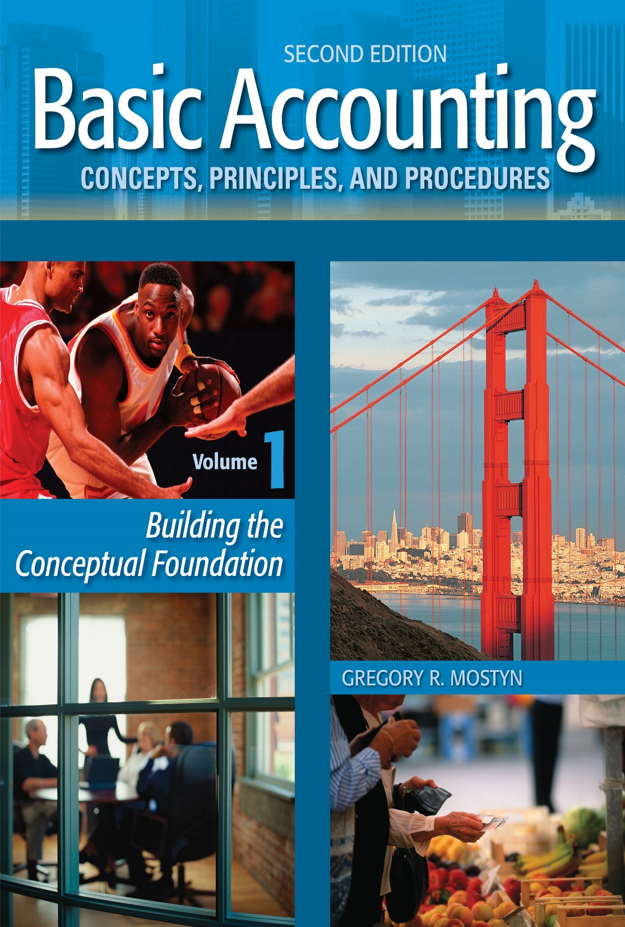
Basic Accounting Concepts Principles and Procedures, 2nd Edition, Volume 1
Basic Accounting Concepts Principles and Procedures, 2nd Edition, Volume 1

Slide 2
Learning Goal 7

Slide 3
Asset and Liabilities Review
• Asset: In accounting, an asset is property that has these qualities:
1) It must provide future benefits (also called “service potential”).
2) It must already be owned by the party claiming it as an asset.
• Liability: A debt
In the following slides we will see examples of the most common assets and liabilities for businesses. These are the ones you are most likely to encounter and should be most familiar with.

Slide 4
Common Assets
Asset Name | Description | Future Benefits/Examples
• Cash | Currency, checking or savings account balance | Most useful asset. Can be used to acquire any other asset, pay debts, or invest.
• Accounts Receivable | The legal right to collect money from customers. Usually requires payment in 30-60 days. Sometimes called “trade receivables”. | Will provide cash in the near future. Facilitates sales by allowing credit. Sometimes accounts receivable can also be sold.
• Note Receivable | The legal right to collect money as a result of a formal signed promise to pay from a borrower. May be short-term or long-term. | Will provide cash in the future from both the amount of the loan plus interest. Can also be sold.
• Interest Receivable | The legal right to collect interest that has been earned on a loan. Usually involves receipt in the near future. | Will provide cash in the near future as a result of the investment return on a loan.
• Supplies | Small physical items that are used up relatively quickly (less than a year) in business operations. | Various benefits depending on type of item – examples: fuel, lubricating material, pens, paper, copy machine toner, employee snacks. Can also be sold.

Slide 5
Common Assets, continued
Asset Name | Description | Future Benefits/Examples
• Prepaid Expense | An advance payment for an expense that will be incurred at a later time. | A benefit will be received later when expense incurred for type of service that is prepaid. Examples: prepaid insurance, prepaid travel, prepaid rent, prepaid subscriptions.
• Merchandise Inventory | Merchandise that is held to be available to sell to customers. | Revenue is created when merchandise is sold. Cash or accounts receivable are received.
• Office Equipment | Long-lasting (greater than a year) physical assets used as part of office operations. | All used to facilitate office work. Examples: computers, books, furniture, filing cabinets, lamps. Can also be sold.
• Other Equipment | Long-lasting (greater than a year) physical assets used in production or other value-adding activities. | All used to facilitate other business operations. Examples: Machinery, automobiles, aircraft. Can also be sold

Slide 6
Common Assets, continued
Asset Name | Description | Future Benefits/Examples
• Buildings | Construction on land in which business operations take place. | A location in which to conduct business operations. Although land and building(s) are usually bought / sold together, they are recorded as separate assets.
• Land | Ground on which buildings or other improvements can be constructed. | Provides a location to construct buildings or other improvements; also used for investment.
• Intangible Assets | These are assets without physical substance. They will be discussed in volume 2. | Examples: copyrights, patents, trademarks, franchise rights.

Slide 7
Common Assets, continued
• Monetary assets: Assets that have monetary value as their sole benefit.
Examples are cash, accounts receivable, and notes receivable. These assets
are not physically consumed.
• Non-monetary assets: Assets that are physically used and consumed in
business operations or primarily provide legal rights. Examples are
supplies, equipment, buildings, and intangible assets. Non-monetary assets
also usually have economic value, and can be sold to obtain cash or
monetary assets.

Slide 8
Common Asset Confusions
It is not usual for certain types of items or situations to be confused with assets or liabilities.
None of the following items are assets. Why not? (See next slide)
1. Employee
2. Rented equipment for user of equipment
3. Broken and not repairable computer
4. Repair services
5. Good credit

Slide 9
Answers
Not assets because:
1. Employee: People are not property and cannot be owned.
2. Rented equipment: The equipment is not owned by who is using it.
3. Broken and not repairable computer: No future benefits.
4. Repair service: Services are not property; they cannot be owned.
5. Good credit: Not property; possible but unclear future benefits.

Slide 10
Common Liabilities
Liability Name | Description
• Accounts Payable | The legal obligation to pay money to vendors and service providers. Usually requires payment in 30-60 days. The opposite of accounts receivable. These are sometimes called “trade payables”.
• Unearned Revenue | An advance payment from a customer that creates the legal obligation to either perform services/deliver product or return the payment.
• Wages Payable | The legal obligation to pay employees for their services.
• Note Payable | The legal obligation to pay money as a result of a formal a borrower’s formal signed promise to pay (called the “note”). May be short-term or long-term. The opposite of a note receivable.

Slide 11
Common Liabilities, continued
Liability Name | Description
• Interest Payable | The legal obligation to pay interest that has been incurred on a loan. Usually requires payment in the near future. The opposite of interest receivable.
• Taxes Payable | The legal obligation to pay a tax that has been incurred.
Note: There may be various other legal obligations that become liabilities that are related to large businesses, such as warranties, refunds, coupons, dividends, and bonds payable. These are discussed in volume 2

Slide 12
Unsecured and Secured Liabilities
• Most business liabilities are unsecured. An unsecured liability means that
it is a general claim against any and all of the assets of a business, along
with all other unsecured liabilities.
• Sometimes liabilities are secured. This happens most often with large
liabilities such as significant loans. It provides additional assurance to a
creditor that a debt will be paid.
A secured liability means that a creditor has the right to seize and sell a
designated asset if a particular loan is not paid on time. A business cannot
dispose of the designated asset until the loan and interest on the loan it
secures is paid. For example, most real estate loans use the property
purchased to secure the loan.

Slide 13
Common Liability Confusion
None of the following items are liabilities. Why not? (See next slide)
1. Hiring an employee
2. Prepaid expense
3. Returnable purchase
4. Defective item purchase
5. An expense

Slide 14
Answers
Not liabilities because:
1. Hiring an employee: Simply hiring an employee does not create a liability if the employee has not performed services yet. Unless there is an employee contract that creates financial obligations, there no liability until services are performed.
2. Prepaid expense: A prepaid expense is an asset.
3. Returnable purchase: There is no obligation to pay within the return period. This often applies to various purchases, including cars and merchandise.
4. Defective item purchase: There is no obligation to pay if the seller did not deliver what was agreed upon.
5. An expense is a decrease in owner's equity caused by using up a resource to operate a business (adding value process). Expenses may or may not involve liabilities (debt).

