Slide 1
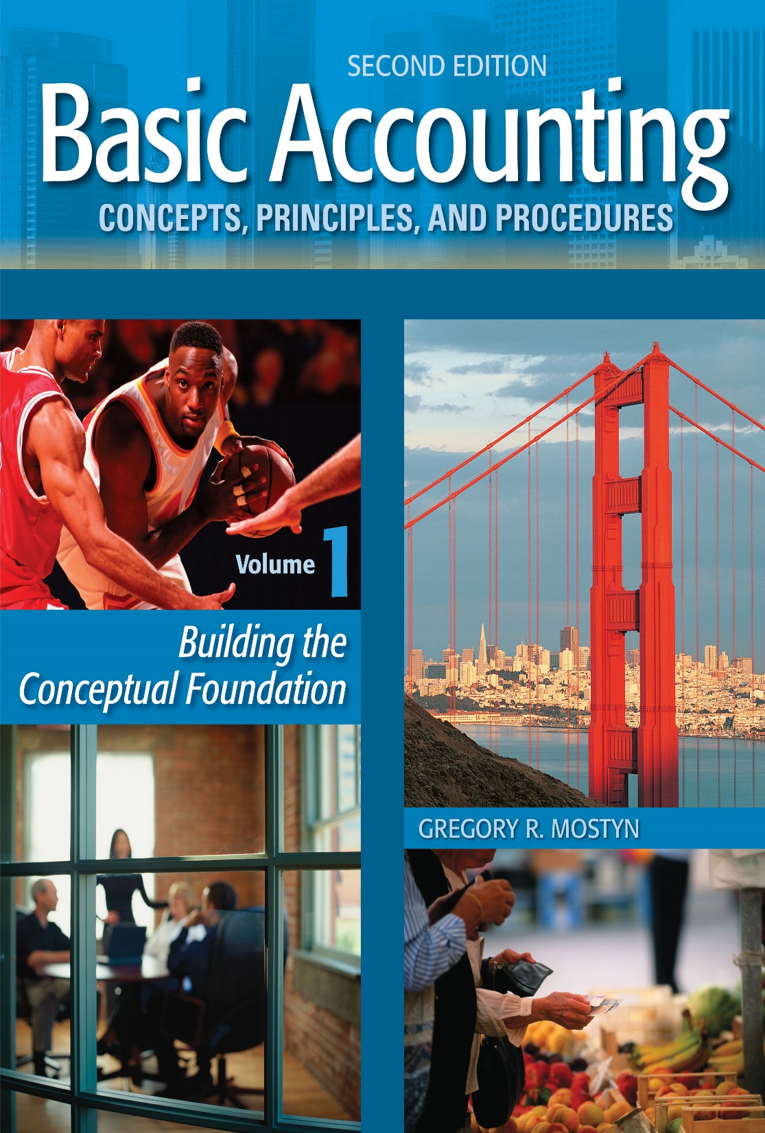
Basic Accounting Concepts Principles and Procedures, 2nd Edition, Volume 1
Basic Accounting Concepts Principles and Procedures, 2nd Edition, Volume 1

Slide 2
Learning Goal 8

Slide 3
The Changes in Owner’s Equity
• There are two possible types of claims on assets. These are the creditors’
claims and the owner’s claim. This is evident when we look at the
accounting equation: A = L + OE

Slide 4
Review of Owner’s Equity
Owner’s equity is the owner’s claim on the wealth of his or her business.
The owner’s equity claim is a residual claim. Creditors have first priority
to receive payment on their claims.
This means that if a business were to be sold or were to go out of business, all assets
would first be used to pay creditors.
Any residual would then go to owner after the creditors were fully paid. If the creditors are not
fully paid, the owner will receive nothing.
The owner’s residual claim can be described by the accounting equation as:
A – L = OE

Slide 5
Review of Owner’s Equity, continued
• Other names for owner's equity: Owner's equity is also called “net
worth” and sometimes “net assets”.
• Name for a specific business: For a specific business (except a corporation) owner’s equity is identified by using the owner’s name followed by the work “capital”.
Example: If your name is Bill Smith, and you are the owner of a proprietorship business, the owner's equity in your business would be called “Bill Smith, Capital”.

Slide 6
The Changes in Owner’s Equity
• Changes in owner's equity are always of vital interest to a business owner.
There are six kinds of changes to owner's equity as discussed in the
following slides.
• An owner usually invests cash, but can also invest other assets such as
supplies or equipment.
• When non-cash assets are invested, the value to use is the fair market value
at the time of the investment. Fair market value can be documented by
evidence of typical sales prices, or even an appraisal.

Slide 7
Increase: Owner Investments
• Owner investments always increase owner’s equity. If an owner invests cash or any other asset in his or her business, owner's equity will increase because assets increase, as shown in the accounting equation:
A = L + OE
• All assets invested in a business by an owner must be accounted for in the records of the business as business assets. The increase in owner's equity is recorded as an increase in owner’s capital, such as “Bill Smith, Capital”.
• Rarely, an owner may invest in a business by personally paying the debts of the business. In this case, the accounting equation would show:
A = L + OE

Slide 8
Decrease: Owner Withdrawals
• A proprietorship business owner can remove cash or other assets from his or her business for personal use. This is called a “withdrawal” or “drawing”. When this is done, the business accounting records will show that the assets have been transferred out of the business to the owner.
• Owner withdrawals always decrease owner’s equity.
• If an owner withdraws cash or any other asset from his or her business, the owner's equity will decrease because assets decrease, as shown in the accounting equation:
A = L + OE
• A business keeps a separate record of all withdrawals. The record is identified with the name of the owner followed by the word “withdrawals” or “drawing”, such as “Bill Smith, Drawing”.
NOTE: Owner withdrawals in a proprietorship are NOT recorded as expenses. See definition of expense on later slide.

Slide 9
Increase: Revenue
• Revenue is an increase in owner's equity as a result of making sales.
• The amount of the revenue is the amount of the sale.
• Revenue increases owner's equity because revenue will always result in either an increase in assets or a decrease in liabilities.
Example #1, Asset Increase: ABC Advertising Company completed a job for customer and billed the customer. The company either will receive cash or have an increase in accounts receivable – in either case, assets increase.
A = L + OE
Example #2, Liability Decrease: A customer of XYZ Advertising Company has already made an advance payment, creating a unearned revenue liability. When XYZ completes the job, revenue is earned and the liability disappears.
A = L + OE

Slide 10
Decrease: Expense
• An expense is a decrease in owner's equity as a result of consuming
resources in order to create value and make sales (also called “operations”).
• The amount of an expense is the cost of the resource consumed.
• An expense decreases owner's equity because an expense will always result
in either a decrease in assets or an increase in liabilities.
Example #1, Asset Decrease: ABC Advertising Company used up $500 of supplies, for supplies expense.
A = L + OE
Example #2, Liability Increase: XYZ Advertising Company received a bill for utilities expense. It does not pay the bill immediately, so the liability Accounts Payable increases.
A = L + OE

Slide 11
Gains
• A gain is similar to revenue. Gains have the same effect on owner's
equity as revenues, so gains increase owner's equity.
• However, a gain is not part of regular business operations, so it is not
called revenue. A gain is an incidental event to being in business.
Example: Equipment that cost $10,000 is sold for $14,000. The gain is $4,000.
• Gains will be discussed in more detail in volume 2.

Slide 12
Losses
• A loss is similar to an expense. Losses have the same effect on owner's
equity as expenses, so losses decrease owner's equity.
• However, a loss is not part of regular business operations, so it is not
called an expense. A loss is an incidental event to being in business.
Example: Equipment that cost $10,000 is sold for $8,000. The loss is $2,000.
• Losses will be discussed in more detail in volume 2.

Slide 13
The Most Powerful Effects on Owner's Equity
• The most influential effect on owner's equity is how well a business is
managed.
• Good management results in continued profitability because
a business is: 1) creating value that customers want, AND
2) sells this value for more than expenses incurred to create it.
Therefore, revenues are greater than expenses. This results in net income,
which increases assets and increases owner's equity.
• Bad management results in net losses because a business is not creating
enough value that customers want or cannot sell the value for more than
the cost to create it.
Therefore revenues are less than expenses. This results in net losses, which
decrease assets and decrease owner's equity.

Slide 14
Summary of All the Changes
Cause | Increase or Decrease | Example
Owner’ Direct Actions
Investment | Increase | Owner invests $10,000 cash in her business plus $4,000 of supplies.
Withdrawal | Decrease | Owner withdraws $3,000 cash from the business checking account for personal use.
Operational Changes
Revenue | Increase | A business sells $500 of services to a customer.
Expense | Decrease | A business uses up $100 of supplies.
Incidental Changes
Gains | Increase | Equipment is sold for more than it cost.
Losses | Decrease | Equipment is sold for less than it cost.

