Slide 1
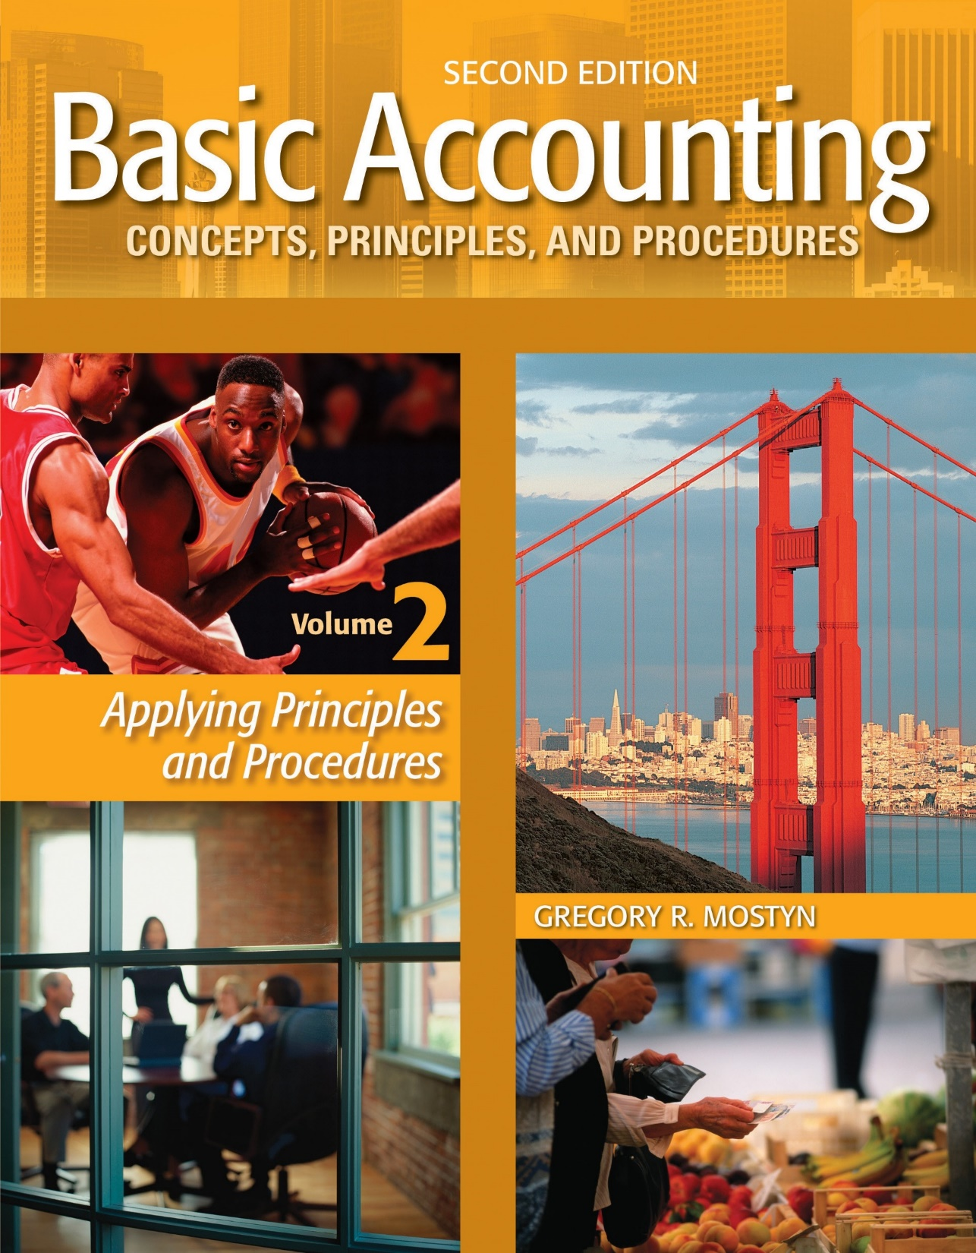
Basic Accounting Concepts Principles and Procedures, 2nd Edition, Volume 1
Basic Accounting Concepts Principles and Procedures, 2nd Edition, Volume 2

Slide 2
Learning Goal 1

Slide 3
The Meaning of “Accounting Period”
• As discussed in volume 1, there are four required financial statements. One
statement shows financial condition at a point in time. The other three
statements show changes in the condition over a period of time.
• Balance sheet: financial condition at a point in time
• Income statement: change statement
• Statement of retained earnings (or stockholders' equity): change statement
• Statement of cash flows: change statement
• Financial changes occur over time. Therefore, in order to measure the
financial changes, a specified period of time, called an accounting period
is used.

Slide 4
The Meaning of “Accounting Period”, continued
• Other features of accounting periods:
• Timeliness: Stakeholders require financial information frequently,
regularly, and predictably.
• Comparability: When time periods are equal, financial reports become
more meaningful, because their changes occur over equivalent periods of
time.
• Fiscal year: All companies prepare financial statements at the end of a period
of one year. A one-year financial period is called a “fiscal year”.

Slide 5
Fiscal Periods
• Fiscal years are for a period of one year; however, a company can select its own fiscal year beginning and ending at points that may be different than the fiscal years of other companies. This is because different companies have different natural cycles of activity.
• A fiscal year usually ends when activity is low at the end of a business cycle.
Fiscal Year | Any consecutive 12-month period of time
Calendar year | A fiscal year that begins on January 1 and ends on December 31
4-4-5 year | A fiscal year that is divided into 4 quarters and each quarter is 13 weeks. The 13 weeks quarter is divided into “months” of three periods of 4 weeks, 4 weeks, and 5 weeks. Some businesses use this method because they want to compare results on a weekly basis with equivalent quarters, and end each quarter on the same day of the week.
52-53 week year | A fiscal year that always ends on the same final selected day of a selected month (i.e. last Saturday in October). Also, a fiscal year that always ends on the same day of the week that is closest to the end of the selected month (e.g. the Saturday closest to last day of October.) Both the 4-4-5 calendar and the 52-53 week year result in a 53 week year about every 5 years, so years are not easily comparable.
Quarter | A consecutive 3-month period. Often referred to as “interim periods”.
Month | A calendar month. Often referred to as “interim periods”.

Slide 6
Measuring Change
• The most important measure of change is the effect that operations have on
stockholders' equity.
• “Operations” are the actions performed by a business to: 1) create
something of value (service or product) and 2) make sales to customers.
• The two basic elements of operations are revenues and expenses.
• A revenue is an increase in stockholders' equity caused by making sales to
customers. The amount of revenue is the dollar amount of sales.
• An expense is a decrease in stockholders' equity caused by using up goods or
services in order to create revenue. The amount of expense is the dollar value
paid or consumed.

Slide 7
Measuring Change: Revenues
• A revenue always increases net income. Net income flows into retained earnings, which is part of stockholders' equity. Therefore, you can say that revenues always increase stockholders' equity.
At the same time, the effect of revenue will always be either an increase in an asset or decrease in a liability.
A | = | L | + | SE
OR
A | = | L | + | SE

Slide 8
Measuring Change: Expenses
• An expense always decreases net income. Net income flows into retained earnings, which is part of stockholders' equity. Therefore, you can say that expenses always decrease stockholders' equity.
At the same time, the effect of an expense will also always either decrease an asset or increase a liability.
A | = | L | + | SE
OR
A | = | L | + | SE

Slide 9
The “Side Effects” of Accounting Periods
• Dividing the life of a business into accounting periods creates issues or “side
effects”, such as:
• How do we know in which accounting period(s) to record revenues?
• How do we know in which accounting period(s) to record expenses?
• What happens when revenues and/or expenses are recorded in the wrong
period(s)?
The next learning goals discuss these topics.

Slide 10
Other Changes
• Although revenues and expenses are the most powerful long-term forces of
change on a business, three other types of changes also have important
effects. These are: cash flow, owner investments, and owner withdrawals.
• Cash is an extremely important asset. Therefore most businesses make
special efforts to identify the sources and uses of cash. These are reported
in the statement of cash flows.
• In a corporation, owner investments take the form of stock purchases.
• In a corporation, owner withdrawals take the form of dividend payments to
stockholders.

