Slide 1
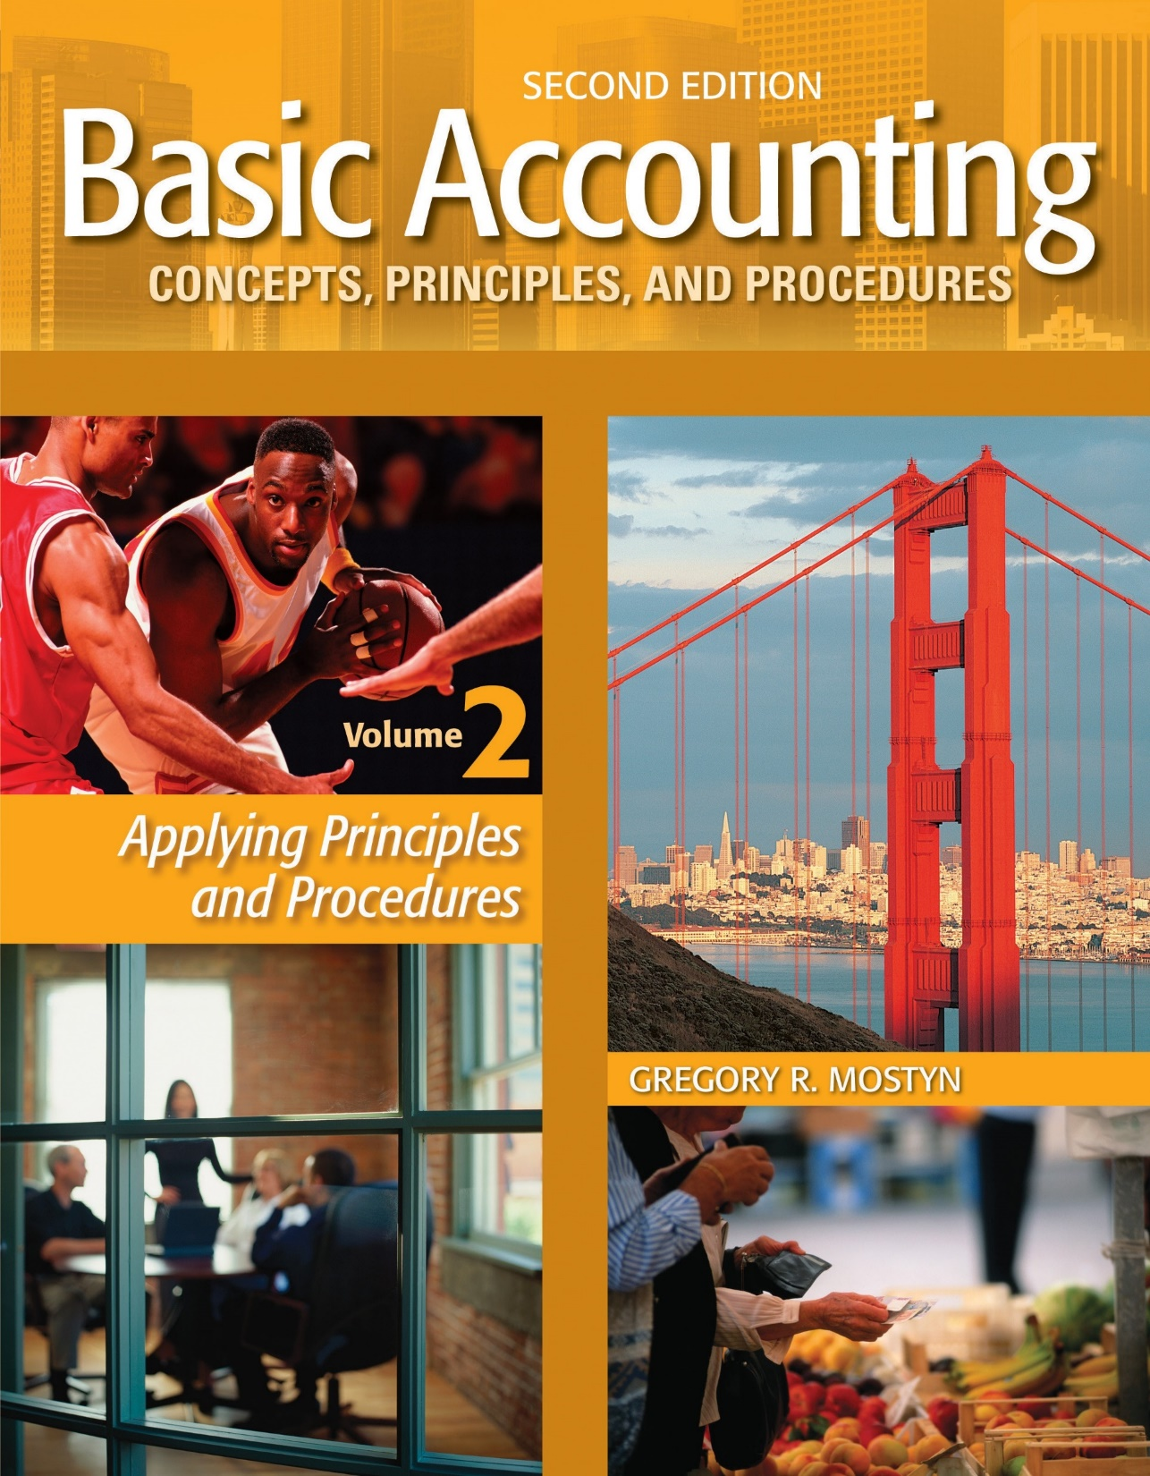
Basic Accounting Concepts Principles and Procedures, 2nd Edition, Volume 1
Basic Accounting Concepts Principles and Procedures, 2nd Edition, Volume 2

Slide 2
Learning Goal 16

Slide 3
How to Report Cash
• What is “cash”? Cash is any of the following:
• Currency and Coin
• Dollar-labeled items: Any dollar-labeled item that a bank will accept as a deposit
• Bank account balances: Checking and savings accounts
• Cash “equivalents”: For financial statement reporting purposes, GAAP allows cash “equivalents” to be reported as cash. These include:
• Money market funds
• Certificates of deposit
• U.S. Treasury securities with an original maturity not exceeding three months

Slide 4
How to Report Cash, continued
• Current asset: On a balance sheet, cash is a current asset
• Restricted cash: Cash is restricted when it can only be used for a specific purpose, such as a loan repayment or an asset purchase. On a balance sheet, restricted cash is reported as a separate asset with its own name. Restricted cash can either be a current or long-term asset, depending on its intended use.
• Compensating balances: A compensating balance is a minimum cash balance that a borrower must maintain, usually required by the terms of a bank loan. Compensating balances must be disclosed in the footnotes to financial statements.
• On the statement of cash flows, the changes in cash are classified as resulting from three possible types of activities: operating, investing, and financing.

Slide 5
Controlling Cash
• Internal Control: Internal control means the policies, procedures, and organizational design that are used to safeguard assets.
• Internal control is used to safeguard all types of assets; however, in this learning goal we are most concerned about using internal control procedures that safeguard cash.
• Cash is an easy asset to steal, the theft is difficult to detect, and loss of cash can be extremely damaging to a business, especially to a small business.
• Small businesses often lack good internal control and frequently become especially vulnerable to asset loss.

Slide 6
Controlling Cash, continued
The following are internal control methods used to safeguard cash from theft and waste:
• Use of checking and savings accounts
• Use of credit cards (bank cards)
• Bank reconciliation
• Voucher system
• Imprest system for petty cash
• Cash receipts internal control procedures, including bonding
• e-commerce procedures

Slide 7
Checking and Savings Account
• Checking and savings accounts provide physical protection for cash. They also facilitate transfer of funds through the use of checks and electronic systems.
• Maintaining cash reserves in a bank may help build a banking relationship that is useful when loans are desired.
• Very small amounts of cash should be kept on a business premises. The amounts can maintained in a petty cash system (discussed later).
• The use of checking and savings accounts also provide a second record of cash. This makes it possible to verify true cash balances by the use of a bank reconciliation (discussed later).

Slide 8
Credit Card Use
• Credit cards provide good cash internal control because no cash is used and a detailed record is maintained by the credit card provider and provided to the user.
• A company can authorize credit card use for designated employees and set card expenditure limits. Therefore a specific employee is clearly responsible for specific expenditures and potential loss is limited to a maximum amount.
Expenditure example:
Ultra Company managers are authorized to use credit cards. The current credit card billing shows the following expenditures: • Transportation: $210 • Supplies $85 • Entertainment $245. Ultra company would record the following:
xx | Transportation Expense | 210
 | Supplies | 85
 | Entertainment Expense | 245
 | Accounts Payable |  | 540

Slide 9
The Bank Reconciliation
• When a checking, savings, or other institutional cash account is maintained, there are two records of cash. The institution maintains a record that is also sent to the customer and the customer maintains its own accounting records for cash.
• A bank reconciliation determines a true cash balance by reconciling the differences between cash balances in these two sets of records.
• To maintain good internal control, a bank reconciliation should be prepared at frequent, regular intervals by the bank customer. Either the owner or someone with no access to paying or receiving cash performs the reconciliation.
• The institutional statement sent to a customer that shows transactions and balances is usually called the bank statement (per bank). The customer accounting record of cash is the cash ledger account.

Slide 10
The Bank Reconciliation, continued
• How does the reconciliation work?
• A bank reconciliation examines transactions on both sets of records.
• The reconciliation corrects any errors and/or omissions on the bank statement when compared to the customer’s accounting records (“per books”).
• The reconciliation also corrects any errors and/or omissions in the customer’s accounting records when compared to the bank statement.
• When completed, a reconciliation will show the same balance for both the bank statement and the cash account.
• A proper reconciliation forces a business to review and analyze its cash transactions. This is what creates the effect of internal control.

Slide 11
The Bank Reconciliation, continued
• The following items are adjustments to the bank statement balance that can be identified by reviewing the accounting records and transaction documents:
• Deposit in transit: A deposit in transit is a deposit made near the end of a current period, but does not appear on the bank statement, because the bank was in the process of preparing the bank statement. A deposit in transit should be added to the bank statement balance.
• Outstanding checks: An outstanding check is a check that has been written but has not yet
been deposited by the payee. An outstanding check should be subtracted from the bank statement balance.
Bank errors: A bank error may be a mistake in a deposit, payment, or service charges. The adjustment to the bank statement balance can be either positive or negative depending on the type of error. A customer should immediately inform the bank of its error.

Slide 12
The Bank Reconciliation, continued
• The following items are adjustments to the balance per books that can be identified by reviewing the bank statement with the accounting records and transaction documents:
• Service charges and bank fees: Often a company may not either be aware of or may not record bank
charges and fees until a bank statement is received. These are subtractions to the balance per books.
• NSF checks: “NSF” means “non-sufficient funds” and refers to deposited checks that do not have
sufficient funds in the maker’s account. Because these deposits were initially recorded, but then not
cleared by the bank, the depositor must subtract them from its book balance. They are usually temporarily
recorded as accounts receivable and then re-deposited (see journal entry later).
• EFT transactions: “EFT” means “electronic funds transfer”. These are amounts that are transferred in
or out of a bank account electronically. Sometimes they are not recorded by a bank customer until a bank
statement is received. Examples are loan payments, automatic payments and deposits, and credit card
sales. These are either additions or subtractions, depending on the type of item.
• Book errors: These are errors in recording deposits and payments. They are either additions or
subtractions, depending on the type of error.

Slide 13
The Bank Reconciliation, continued
• Bank debits and credits: From the point of view of a bank, a checking or savings account is a liability. Under
normal circumstances, a customer can demand payment at any time. Therefore, when a bank increases an
account it is a credit on the books of the bank. A decrease is a debit.
• Bank memoranda (“bank memos”): A bank often sends debit and credit memos to customers to indicate
account increases and decreases. A credit memo indicates an account increase and a debit memo indicates an
account decrease.
On a bank statement “CM” usually refers to a credit memo and “DM” refers to a debit memo.

Slide 14
The Bank Reconciliation, continued
Procedure:
1) Select a Cash ledger account date that is the same as or soon after the bank statement date. This will be the
date of the reconciliation.
2) Compare each check amount in the cash payments journal to the check amount on the bank statement.
3) Compare each deposit amount in the cash receipts journal to the deposit amount in on the bank statement.
4) Check the Cash ledger account for charges and credits in the bank statement not yet recorded. Use
the posting references in the ledger account to check if there are any other debit or credit entry sources.
5) Check to see what prior deposits in transit and outstanding checks have cleared the bank (are on the bank
statement).

Slide 15
The Bank Reconciliation, continued
Example: A completed bank reconciliation is illustrated below.
Our Company, Inc. Bank Reconciliation June 30, 2017
Balance Per Bank, June 30 |  |  | $73,754.31
Add: Deposit in transit, June 30: |  |  | 5,185.00
Less: Outstanding Checks
No. 423 | 2,750.00
No. 445 | 486.40
No. 447 | 849.50
 |  |  | (4,085.90)
Adjusted Bank Balance, June 30 |  |  | $74,853.41
Balance Per Books, June 30 |  |  | $73,579.16
Add:
EFT for account receivable collection | 1,700.25
Deposit error, 6/04 (Unearned revenue) | 36.00
Less: |  |  | 1,736.25
Bank service charges | 12.00
NSF deposit | 50.00
EFT (Insurance prepayment) | 400.00
 |  |  | (462.00)
Adjusted Book Balance, June 30 |  |  | $74,853.41

Slide 16
The Bank Reconciliation, continued
Journal entries:
• If there are any adjustments to the balance per books on a bank reconciliation, adjusting entries are needed.
• For example, on the prior illustration, the unadjusted book balance is $73,579.16. However the reconciled cash balance is $74,853.41. This is the balance that must appear in the cash ledger account as of the reconciliation date, because it is the correct cash balance.
• The following journal entries would be prepared. (The NSF check is recorded as an account receivable.)
6/30 | Cash | 1,736.25
 | Accounts Receivable |  | 1,700.25
 | Unearned Revenue |  | 36.00
 | Service Charges Expense | 12.00
 | Accounts Receivable | 50.00
 | Prepaid Insurance | 400.00
 | Cash |  | 462.00

Slide 17
The Petty Cash Fund
• Petty cash means a small amount of cash. This is usually cash that is kept on business premises for minor cash expenditure needs.
• Internal control procedures apply to petty cash. The following should be implemented:
• Petty cash should be “petty”; in other words, large amounts of cash should not be kept on business premises. Significant expenditures should be made in other ways.
• Petty cash should be supervised by a designated individual responsible for record keeping and cash handling.
• Petty cash should be maintained in a controlled safe location.
• An imprest system of petty cash reconciliation should be used (see next slide).

Slide 18
The Petty Cash Fund, continued
• An imprest system for petty cash is a system in which the record of expenditures plus the remaining petty cash must always equal the total funds designated for petty cash.
Step 1: Create a petty cash fund. A check is written to the person supervising petty cash, often called the “petty cash custodian”. This person cashes the check and places the cash in a safe or controlled location (e.g. petty cash locked box). Example: The journal entry to create a $300 fund would be:
xx | Petty Cash | 300
 | Cash |  | 300
Step 2: Petty cash vouchers (a verification document) are used. When someone requests cash, that person must first fill out a voucher with name, date, dollar amount, and purpose. The voucher is placed in the petty cash box as the money is removed.
Therefore, the remaining cash plus vouchers total must equal the fund total (in this example $300).

Slide 19
The Petty Cash Fund, continued
Step 3: Replenish the fund. This is done no later than the end of an accounting period, or sooner if funds are depleted. The petty cash custodian summarizes and totals the vouchers by amount and type of expenditure. These are recorded as the fund is replenished.
Example: Voucher totals in the $300 petty cash fund are as follows ($36 remains in the petty cash box):
• Transportation: $115
• Entertainment: $45
• Postage: $30
• Supplies $74
The journal entry to reimburse the fund is:
xx | Transportation Expense | 115
 | Entertainment Expense | 45
 | Postage Expense | 30
 | Supplies | 74
 | Cash |  | 264
The petty cash account maintains a constant balance unless it is later increased (debit Petty Cash) by adding more cash or decreased (credit Petty Cash) by not reimbursing the full amount.

Slide 20
The Petty Cash Fund, continued
• Cash Over and Short: This is an account used for small, unidentified differences that may occur when vouchers are reconciled with remaining cash. Cash short (a debit) is like a small miscellaneous expense. Cash over (a credit) is
like a small miscellaneous revenue or expense offset.
` Example: Assume in the example above that when cash was counted the total was $33.
xx | Transportation Expense | 115
 | Entertainment Expense | 45
 | Postage Expense | 30
 | Supplies | 74
 | Cash Over and Short | 3
 | Cash |  | 267

Slide 21
Change Funds
• A change fund is an amount that is placed in a cash register at the beginning of business hours in order to
make change, if needed. It is removed at the end of the day or at the end of a shift and cash count.
Example: A check is cashed and at the beginning of the day and $150 cash is placed in a cash register.
xx | Change Fund | 150
 | Cash |  | 150
At the end of the day, the cash register tape shows total sales of $930, so a total of $1,080 cash should be in the cash register.
Cash over and short accounts can also be used for cash register cash counts, but the differences should be small and random.

Slide 22
Voucher Systems
• A voucher system is designed to apply internal control procedures to cash payments in a large company,
where requests for cash payments can come from many different sources.
• A “voucher” in a voucher system is a document that validates the authenticity of a transaction that requires a cash payment. It also verifies the occurrence of each step in the process that ultimately leads to the payment.
• Beginning with the initial request, the voucher document requires both an authorized signature approval for each step in a sequence leading to payment as well as all accompanying documentation such as a purchase order, receiving report, a payroll request, a loan payment request, and final accounting department review, before a check is prepared.
• In a comprehensive voucher system no payment is made without an approved voucher.
• A voucher system implements control through the separation of duties. Because various signatures, documentation, and final approval are required, fraudulent payments become much more difficult.

Slide 23
Overview of Cash Receipts Internal Control
• There are numerous circumstances in which cash can be received. The most common situations are checks received through the mail and cash receipts for merchandise sales. Internal control procedures have to be adapted to each particular situation.
Cash Sales Example:
• All sales are recorded in a cash register that is locked and has an internal paper tape. Customers always receive a receipt.
• Merchandise is priced at uneven amounts requiring clerk to make change
• At end of shift supervisor unlocks register and removes tape and cash. Supervisor and sales person count the cash together. Supervisor prepares cash count sheet that reconciles to tape and that goes to cashier with tape and cash. Copy goes to accounting department.
• Treasurer prepares daily deposit sheet, deposit slips, and takes funds to treasurer for deposit.
• Accounting department verifies cash count sheet with daily deposit sheet and deposit record and records
transaction.
• Credit card sales are reconciled to credit card sales report.

Slide 24
Key Principles of Internal Control
• Separation of duties: 1) Related duties are separated as much as possible. 2) The accounting function is always separated from access to assets. 3) Other departmental authority over accounting is identified and limited to managerial levels.
• Assignments and responsibilities are clearly identified and limited.
• Employees are fairly compensated.
• All transactions are recorded – no exceptions.
• All transactions are documented – no exceptions.
• Assets are physically or electronically controlled and identified.
• Assets and liabilities are verified at regular intervals.
• Bonding: employees that handle cash, valuable inventory, or perform accounting functions should be bonded. (Bonding is a method of insurance for employee theft. It also usually requires an employee background check.)

Slide 25
Key Principles of Internal Control, continued
• Can a small business with just a few employees have adequate internal control?
1) Yes, but most of the internal control duties will be the responsibility of the owner.
2) The owner can also periodically or regularly utilize the services of accounting firms.

Slide 26
Internet Issues
• Because transactions frequently involve Internet activity, internal control must apply here as well.
• There are numerous elements related to Internet activity, but the following key actions are essential:
• System access control, such as firewalls and controlled passwords that require regular change
• Virus and hacking protection software that is automatically updated
• Continual employee education about current Internet scamming
• Credit card verification systems for online credit card purchases

