Slide 1
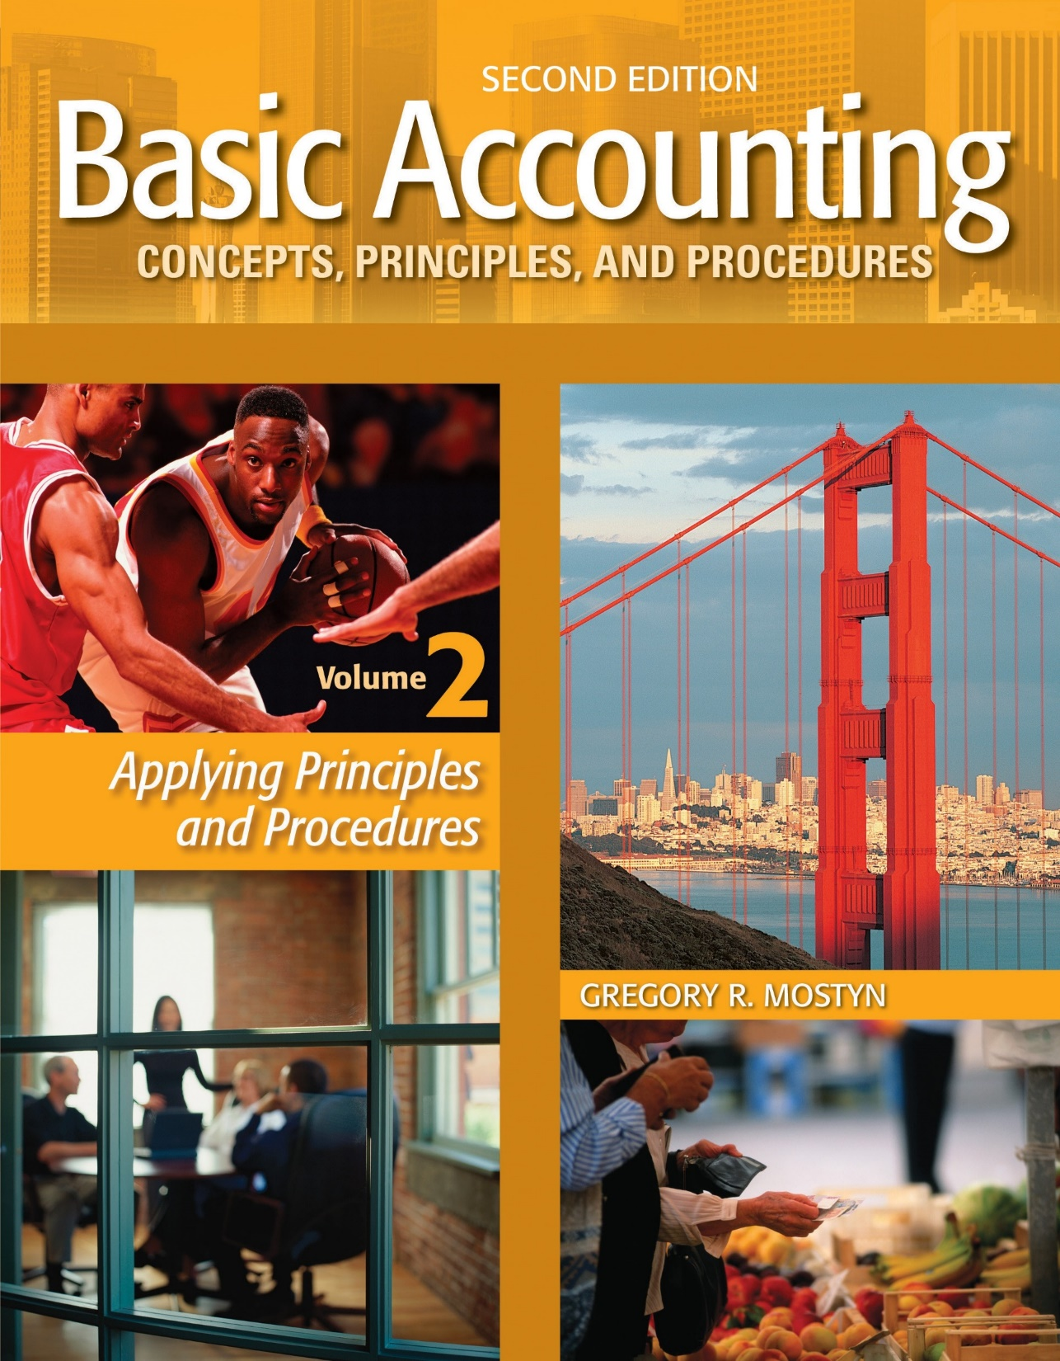
Basic Accounting Concepts Principles and Procedures, 2nd Edition, Volume 1
Basic Accounting Concepts Principles and Procedures, 2nd Edition, Volume 2

Slide 2
Learning Goal 19

Slide 3
Overview: Fixed Assets
• Definition: Fixed assets are long-term (longer than 1 year life) assets used for a
productive purpose (the adding-value process).
Examples:
• Machinery • Furniture • Computer • Building and Land
Non-Examples (not fixed assets):
• Supplies, because they are used up relatively quickly
• Land held for investment rather than production
• Merchandise inventory because it is held primarily for sale
Main fixed asset issues:
• How to record acquisition expenditures
• How to record operations expenditures
• How to record loss of value and future benefits
• How to record disposals of fixed assets

Slide 4
Property, Plant, and Equipment
Purchases
• Definition: Property, plant, and equipment assets have the following qualities:
• Are acquired for productive use in operations and not for resale
• Are long-term (will be used for more than one year)
• Have physical substance (are tangible assets)
• Rule for how to record: A property, plant, and equipment asset should be recorded at a cost that 1) includes all costs that are normally required to acquire the asset and 2) put it in its initial normal operating condition.
• Capitalization: To capitalize an expenditure means to record an asset. The opposite of capitalizing is to record an expenditure as an expense. The rule above is for capitalizing property, plant, and equipment expenditures.

Slide 5
Property, Plant, and Equipment Purchases, continued
Examples of applying the rule:
• Equipment: Cost includes list price less discounts, plus taxes, freight costs when paid by the buyer, insurance while in transit, assembly, normal installation procedures, and normal testing. Loan interest is not capitalized.
• Buildings: Cost includes purchase price and buying costs, make-ready costs, and prior unpaid property taxes. Loan interest is not capitalized. Construction costs include all material, labor, and services related to the asset.
• Land: Cost includes purchase price and all buying costs, prior unpaid property tax, landscaping, and all costs for razing and grading needed to prepare the land for its intended use.

Slide 6
Property, Plant, and Equipment Purchases, continued
• Land improvements: Costs are recorded in a separate account for land improvements such as driveways, fences, parking lots, lighting, and any other depreciable items of limited life related to the property.
• Construction period interest and taxes: Interest on borrowed money used to construct a building is capitalized until the construction period is completed and the building is ready for its intended use. The same rule applies to real estate taxes during a construction period.

Slide 7
Property, Plant, and Equipment
Purchases, continued
• Lump sum (group) purchases: Property, plant, and equipment assets purchased as a group are individually allocated cost based on relative appraised or fair market value of each asset.
Example: Singh Corporation buys land, building, and equipment together in a lump sum purchase for $4,000,000. An appraisal report shows the following asset values:
Land: $2,000,000; building: $2,300,000, and equipment: $700,000.
Each asset is capitalized and recorded in individual accounts as follows:
Land: $4,000,000 X ($2,000,000 / 5,000,000) = $1,600,000
Building: $4,000,000 X ($2,300,000 / 5,000,000) = $1,840,000
Equipment: $4,000,000 X ($700,000 / 5,000,000) = $ 560,000
Total $4,000,000

Slide 8
Property, Plant, and Equipment
Operating Expenses
• Operating expenses: Operating expenses for property, plant, and equipment primarily consist of: 1) depreciation, 2) repairs and maintenance.
• Depreciation review: Depreciation is the allocation of the cost of a long-term tangible asset into expense over the estimated useful life of the asset. Depreciation is an application of the matching principle. It is caused by both physical wear and tear and by obsolescence.

Slide 9
Property, Plant, and Equipment
Operating Expenses, continued
• Straight-line method: In learning goal 4 (adjusting entries) we discussed the depreciation adjusting entry using the straight-line method of depreciation. The straight-line method is a common method of depreciation that allocates an equal amount of depreciation into each period of an asset’s useful life.
Example: A machine that cost $12,000 has an estimated residual value of $1,000, and has an estimated useful life of 5 years. Calculation:
($12,000 – $1,000) / 5 = $2,200 per year.

Slide 10
Property, Plant, and Equipment
Operating Expenses, continued
• Other methods: There are other methods for depreciation. We will discuss two commonly used methods below. These are the double-declining balance method and the units of output method.
• The double-declining balance depreciation method allocates more depreciation expense into the early years of an asset’s life, and less in later years. It is sometimes called an “accelerated method”. The calculation method to determine the amount of depreciation is:
Step 1: Calculate the straight-line rate, then double it. This is the double-declining rate used for each period of depreciation.
Step 2: Multiply the asset’s book value (cost minus accumulated depreciation) at the beginning of the period times the double-declining rate.
For the final period: subtract any estimated residual value from the book value at the beginning of the final period.

Slide 11
Property, Plant, and Equipment
Operating Expenses, continued
Double-declining method example: At the beginning of year 1, Montague Company purchased new equipment for $25,000. The equipment is estimated to have a 5-year useful life and a residual value of $2,000.
Current Year Calculation |  |  |  |  |  | End of Year
Year | Book Value Start of Year | X | DDB Rate | = | Annual Expense | Accumulated Depreciation | Book Value
1 | $25,000 | X | .4 | = | $10,000 | $10,000 | $15,000
2 | 15,000 | X | .4 | = | 6,000 | 16,000 | 9,000
3 | 9,000 | X | .4 | = | 3,600 | 19,600 | 5,400
4 | 5,400 | X | .4 | = | 2,160 | 21,760 | 3,240
5 | 3,240 | 3,240 – 2,000 |  |  | 1,240 | 23,000 | 2,000
Compared to straight-line: Straight-line depreciation would be $4,600 per year.
Switch to straight-line: Often a company will switch to straight-line for remaining years at the point at which straight line exceeds or is about the same as double-declining balance. In this example, that would be about year 3.

Slide 12
Property, Plant, and Equipment
Operating Expenses, continued
Partial year example: Assume that the asset was purchased March 30 of a calendar year instead of at the beginning of a year. The calculations would be:
Year 1: ($25,000 X .4) X 9/12 = $7,500
Year 2: ($25,000 – $7,500) X .4) = $7,000
Year 3: ($25,000 – $14,500) X .4) = $4,200 and so on.
Why use the declining balance method?
• From a theoretical standpoint, depreciation should be applying the matching principle as accurately as possible. In fact, many assets do seem to provide greater benefits earlier in their lives than in later years, when they operate less efficiently.
• Some companies use accelerated depreciation methods for tax purposes. Accelerated depreciation is a non-cash expense that lowers net income and therefore lowers income tax in the early years of an asset’s life. However, in the later years, there is less expense.

Slide 13
Property, Plant, and Equipment
Operating Expenses, continued
• Units-of-production method: This method calculates a fixed amount of depreciation expense per unit of output that an asset produces. The method should only be used when obsolescence or time is not a significant factor in the future benefits provided by an asset.
The calculation method to determine the amount of depreciation is:
Step 1: Estimate the useful life an asset in terms of units of product or service that it can provide.
Step 2: Determine depreciation expense per unit as:
(Cost – Residual value) / Units-of-production
Step 3: At the end of each period multiply the units produced by expense per unit.

Slide 14
Property, Plant, and Equipment
Operating Expenses, continued
Units-of-production method example: Hometown Rental Truck Company estimates that its rental trucks will provide 50,000 miles of service before they are sold. The company purchases a truck for $80,000. It estimates $12,000 residual value. The table below shows actual mileage and the resulting depreciation.
Expense per unit: ($80,000 – $12,000) / 50,000 = $1.36 per mile.
Current Year Calculation |  |  |  |  |  | End of Year
Year | Units of Production (Miles) | X | Expense per Unit | = | Annual Expense | Accumulated Depreciation | Book Value
1 | 5,000 | X | $1.36 | = | $ 6,800 | $ 6,800 | $73,200
2 | 14,000 | X | 1.36 | = | 19,040 | 25,840 | 54,160
3 | 20,000 | X | 1.36 | = | 27,200 | 53,040 | 26,960
4 | 8,500 | X | 1.36 | = | 11,560 | 64,600 | 15,400
5 | 2,500 | X | 1.36 | = | 3,400 | 68,000 | 12,000

Slide 15
Property, Plant, and Equipment
Operating Expenses, continued
Income Tax Depreciation
• For federal income tax purposes, depreciation is calculated by selecting a depreciation table from a set of prescribed tables. Use of the tables is mandatory. The table to use is determined by the type of asset.
• The federal system is called MACRS for “Modified Accelerated Cost Recovery System”.
• The tables generally provide for accelerated depreciation but straight-line is also available. Certain special elections may allow additional depreciation in year of purchase.
• Many states conform to this system or use a similar system.

Slide 16
Property, Plant, and Equipment
Operating Expenses, continued
• What if the estimate of asset life was wrong? The exact useful life of an asset cannot be precisely predicted.
• Actual useful life is more than estimated: If an asset continues to operate and provide benefits beyond its estimated useful life, nothing needs to be done. This means that expense was allocated over fewer years than it should have been.
This should not happen consistently, but accounting is not always precise.
• Actual useful life is less than estimated: If an asset ceases to provide benefits before the end of its estimated useful life, a loss needs to be recorded in the final year. (See later slides.)
Before this happens, if there are indications of shorter life or fewer benefits an impairment loss may need to be recorded (see later slides).

Slide 17
Property, Plant, and Equipment
Operating Expenses, continued
• Changing the useful life estimate: If it appears that the estimate of useful is significantly incorrect, the useful life can be changed.
Step 1: Determine the remaining years of useful life.
Step 2: Determine the remaining book value.
Step 3: Depreciate the remaining book value over the remaining years.
Example: A machine that cost $12,000 has an estimated residual value of $1,000, and has an estimated useful life of 10 years. After 3 years of straight-line depreciation, the useful life is revised to 7 years.
Step 1: 7 – 3 = 4
Step 2: $12,000 – ($1,100 X 3) = $8,700
Step 3: ($8,700 – 1,000) / 4 = $1,925 revised depreciation expense per year

Slide 18
Property, Plant, and Equipment
Operating Expenses, continued
Misunderstandings about depreciation
• Depreciation means a loss of sales value: In accounting and finance, depreciation is an allocation of acquisition cost over estimated useful life. It has nothing to do with sales value.
• “Accumulated depreciation” is a cash reserve fund: Accumulated depreciation is a contra-asset account. It has nothing to do with cash.
If there were a cash reserve, it would appear as a cash account.
• “Reserve for depreciation” is a cash reserve fund: Same as above. No cash.
• Depreciation is a source of cash: Depreciation is simply a non-cash expense, like using up supplies.

Slide 19
Property, Plant, and Equipment
Operating Expenses, continued
• Repairs and maintenance: Repairs and maintenance should be distinguished from capital expenditures.
Repairs and maintenance keep an asset in its normal operation condition. Therefore, they are expenses.
Examples are painting, cleaning, parts replacement, and lubrication.
• “Extraordinary” repairs: Any “repair” that materially extends an asset’s life or materially improves it function is a capital expenditure.
For these expenditures, an asset’s accumulated depreciation account should be debited (reduced). Depreciation expense may need to be recalculated.

Slide 20
Property, Plant, and Equipment
Impaired Assets
• An impaired asset is an asset that has lost a significant amount of economic value. Impairment generally refers to property, plant, and equipment assets.
• Test for impairment:
1) Check for indicators: Indicators would include material decrease in sales value, negative cash flows, operating losses because of the asset, material change in use, or plans to dispose of the asset.
2) If any of the above or other indicators are present, do the following:
Step 1: Determine the current book value.
Step 2: Estimate the future cash flows from the asset (undiscounted).
Step 3: If the amount from step 2 is less than the amount in step 1, the asset is impaired.
• Record loss: Record loss if the if the current net sales price is lower than book value.

Slide 21
Property, Plant, and Equipment
Impaired Assets, continued
Example: Equipment has a cost of $20,000 and accumulated depreciation of $14,000. Future estimated cash flows from the equipment (including likely sales price) are $5,000. The current likely net sales proceeds after expenses of sale are $3,100.
Step 1: $20,000 – $14,000 = $6,000.
Step 2: $5,000
Step 3: $5,000 < $6,000. Asset is impaired.
Loss: $6,000 – $3,100 = $2,900
Journal entry: Eliminate accumulated depreciation and then reduce the asset cost
down to its current fair market value.
xx | Accumulated Depreciation | 14,000
 | Impairment Loss | 2,900
 | Equipment |  | 16,900

Slide 22
Natural Resources
• Examples: Natural resources are assets on or in land such as timber, minerals, oil, and gas.
• Acquisition: Expenditures for natural resources are capitalized as assets. There are some exceptions for oil and gas resources.
• Land use: Land is not depreciated. The exceptions are:
1) Loss due to toxic waste and extraction damage
2) Removal of natural resources, called depletion

Slide 23
Natural Resources, continued
• Depletion calculation: Depletion is similar to units-of-production depreciation.
Step 1: Estimate the total natural resource in units
Step 2: Calculate the cost per unit
Step 3: Depletion amount: Multiply cost per unit by total extracted units
Step 4: Cost of goods sold: Multiply cost per unit units by units sold.
Example: Extraction Corporation owns land that contains copper ore. The land cost $75,000,000 and is estimated to contain 10,000 tons of ore. In the first year, 1,000 tons were extracted and 800 tons were sold.
Step 1: 10,000 tons
Step 2: ($75,000,000 – $0 residual value) / 10,000 = $7,500 per ton.
Step 3: $7,500 X 1,000 = $7,500,000 total depletion amount
Step 4: 800 X $7,500 = $6,000,000 cost of goods sold. $7,500,000 – $6,000,000 = $1,500,000 unsold inventory.

Slide 24
Natural Resources, continued
Journal entry: Record the inventory, depletion, and cost of goods sold for the product sold.
xx | Ore Inventory | 7,500,000
 | Accumulated Depletion |  | 7,500,000
 | Cost of Goods Sold | 6,000,000
 | Ore Inventory |  | 6,000,000

Slide 25
Intangible Assets
• Definition: An intangible asset is a long-term asset with no physical substance that is not a financial
instrument. Most intangibles are legal rights.
Examples:
• Patent: An exclusive right granted by the U.S. government to produce and sell and sell the result of invention. The right is generally for 20 years.
• Trademark: An exclusive right granted by the U.S. government to use a product-related word, description, title, or symbol for at least 10 years, plus 10-year renewals.
• Copyright: An exclusive right granted by the U.S. government to reproduce and sell a published or artistic work for the life of the creator plus 70 years.

Slide 26
Intangible Assets
• Franchise: A contractual right between an owner (“franchisor”) and the user (“franchisee”), in which the franchisee pays the franchisor to exclusively use the franchisor name and sell franchisor products in a designated geographic area.
• Goodwill: The excess paid for a business above the fair market value of the owner’s equity. Life is indefinite until value is determined to no longer exist.
• Leasehold: The right to occupy a building or land with a long-term lease agreement.

Slide 27
Intangible Assets, continued
• Cost amortization: Intangible assets cost money. Similar to depreciation, the cost of these assets must recorded as an expense each period over the estimated period of benefits.
This process for intangible assets is called amortization.
• Rule: Using a straight-line method, record an expense each period over the shorter of the asset’s legal life or estimated useful life. Intangible assets with indefinite lives are regularly tested for impairment.
Example: A patent is purchased for $500,000. It has a legal life of 20 years is estimated to be useful for only 10 years. Amortization is $500,000 / 10 = $50,000 per year.
Journal entry:
xx | Amortization Expense | 50,000
 | Patent |  | 50,000

Slide 28
Fixed Asset Disposals
• Three methods of disposal:
1) Scrap (discard) the asset
2) Sell the asset
3) Exchange the asset for another asset (Discussed in text appendix)
• Scrapping a fixed asset: Debit accumulated depreciation and credit the asset.
• Example: Our Company scrapped equipment that was no longer functional. The asset cost $20,000 and had recorded accumulated depreciation of $17,000.
Journal entry:
xx | Accumulated Depreciation | 17,000
 | Loss on Disposal | 3,000
 | Equipment |  | 20,000

Slide 29
Fixed Asset Disposals, continued
• Selling a fixed asset: Debit accumulated depreciation, debit cash or other asset received, and credit the asset sold. Gain or loss is the difference between book value and the asset received.
• Example #1 : Our Company sold equipment for $2,000 cash. The equipment cost $20,000 and had recorded accumulated depreciation of $17,000.
Journal entry:
xx | Cash | 2,000
 | Loss on Sale | 1,000
 | Accumulated Depreciation | 17,000
 | Equipment |  | 20,000
• Example #2: Our Company sold equipment for $5,000 cash. The equipment cost $20,000 and had recorded accumulated depreciation of $17,000.
Journal entry:
xx | Cash | 5,000
 | Accumulated Depreciation | 17,000
 | Gain on Sale |  | 2,000
 | Equipment |  | 20,000

Slide 30
Financial Statement Presentation
• Balance sheet: Fixed assets are long-term. They are presented in a separate section under long-term investments. If there are no long-term investments, fixed assets are presented under current assets. Intangible assets are generally presented under fixed assets.
Total current assets........................... |  |  | $xxx
Long-term investments........................ |  |  | xxx
Property, Plant, and Equipment
Land ................................................. | $745,000
Land improvements....................... | 151,000
Buildings......................................... | 600,000
Equipment......................................... | 198,000
Less: accumulated depreciation…..... | (490,000)
 |  | $1,204,000
Mineral lands..................................... | 3,000,000
Less: accumulated depreciation…..... | (720,000)
 |  | 2,280,000
Total Property, plant, and equipment |  |  | 3,484,000
Intangible assets
Patents net of accumulated
amortization of $10,000 |  |  | 120,000

Slide 31
Financial Statement Presentation, continued
• Income statement:
• Depreciation is an operating expense. It can be classified as either a selling expense or general and administrative, depending on use.
• Depletion is the cost of a natural resource, and becomes cost of goods sold.
• Amortization is an operating expense. It is usually classified as a general and administrative expense.

