Slide 1
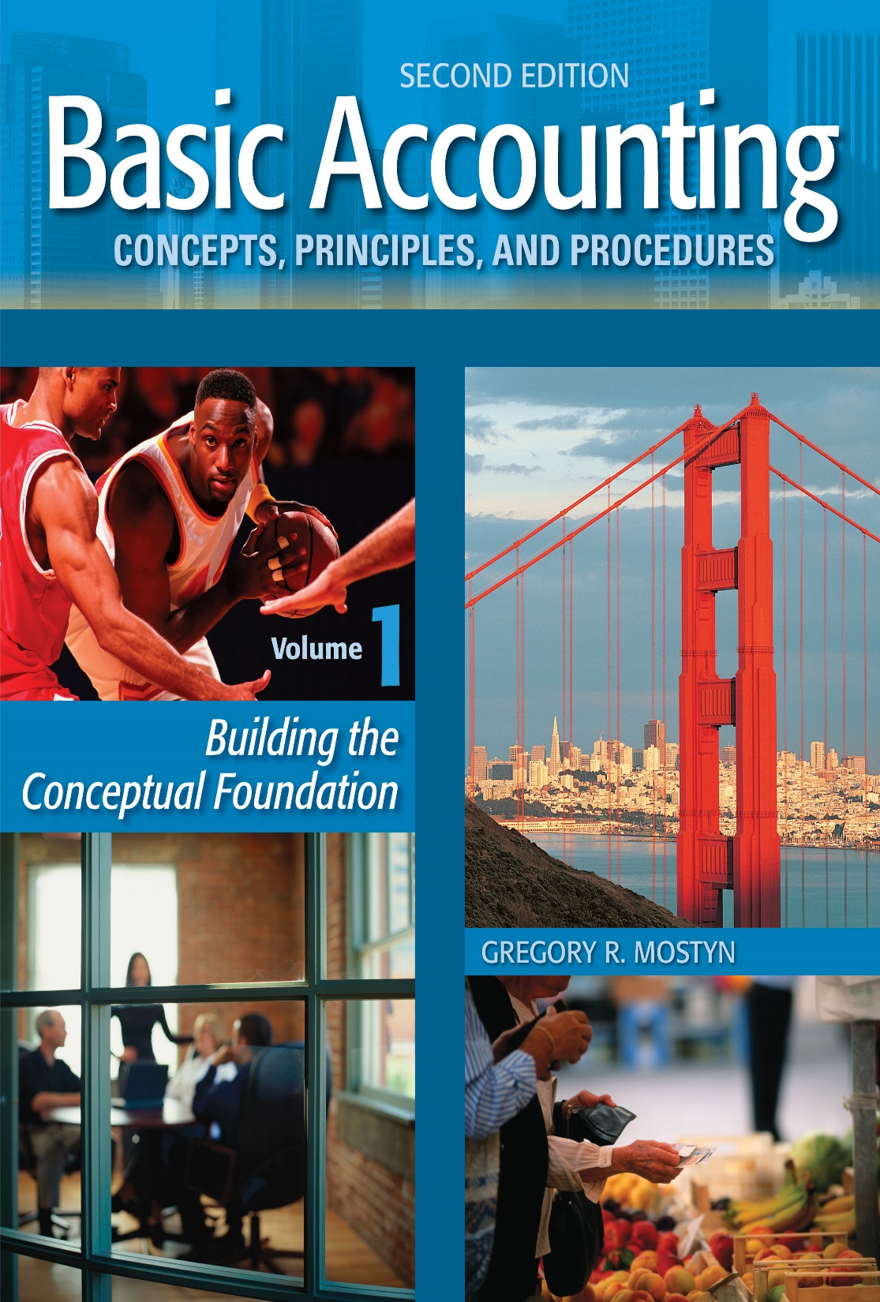
Basic Accounting Concepts Principles and Procedures, 2nd Edition, Volume 1
Basic Accounting Concepts Principles and Procedures, 2nd Edition, Volume 1

Slide 2
Learning Goal 18

Slide 3
The objective of accounting
Provide useful information for:
• Making good decisions
• Assessing future cash flow
• Evaluating assets and claims on assets
• Making good decisions: Providing useful financial information that facilitates good decisions is the fundamental, essential objective of accounting. There are many kinds of vital decisions that depend on financial information: investing, lending, managing, buying, selling, negotiating, employment, and others.
• Assessing future cash flow: Cash is the lifeblood of almost every aspect of business operations, and every business must use financial information to manage cash carefully.
• Evaluating assets and claims on assets: This means being informed about the wealth and productive resources of a business (assets), who can claim the assets, and the transactions that demonstrate how assets are being used to create profits.

Slide 4
The primary qualities of accounting information
Useful information for:
• Making good decisions
• Assessing future cash flow
• Evaluating assets and claims on assets
Objective
Reliability
Relevance
Primary Qualities
(See next slide)
Financial information has various qualities. The two most important qualities are:
• Reliability: The information is dependable and it can be verified. It is free from bias and free from any
material error.
• Relevance: The information is pertinent to the current condition of the entity to which the information
applies. Relevant information is timely and is important enough to make a difference in a decision.

Slide 5
Statement Elements
Assets, liabilities, owner's equity, revenues, expenses, gains and losses.
Financial Statements
• Balance sheet
• Income statement
• Statement of owner's equity
• Statement of cash flows
Source of Information
Source of information
Financial information is primarily provided by four general-purpose financial statements: the balance sheet, income
statement, statement of owner's equity, and statement of cash flows. These explain various key financial aspects of a
business.
Financial statement elements
The financial statements contain certain specific elements: assets, liabilities, owner's equity, revenues, expenses, gains and losses. Note: At this point we do not yet need to discuss gains and losses, which are similar to revenues and expenses.
Review question: Can you identify the financial statements on which the seven elements listed above can be found?

Slide 6
GAAP – the guidance for preparing accounting information
Useful information for:
• Making good decisions
• Assessing future cash flow
• Evaluating assets and claims on assets
Objective
• Reliability
• Relevance
Primary Qualities
Statement Elements
Assets, liabilities, owner's equity, revenues, expenses, gains and losses.
Financial Statements
• Balance sheet
• Income statement
• Statement of owner’s
equity
• Statement of cash flows
Source of Information
Generally Accepted Accounting Principles
(GAAP)
Accounting Standards Codification
GAAP

Slide 7
GAAP – the guidance for preparing accounting information continued
Generally Accepted Accounting Principles (GAAP)
Generally accepted accounting principles provide detailed guidance for how to record and present transaction data that become information in the financial statements. This GAAP guidance is located in a single source called the “Accounting Standards Codification” (ASC) that categorizes, identifies, and describes the guidance.

Slide 8
Underlying assumptions
Useful information for:
• Making good decisions
• Assessing future cash flow
• Evaluating assets and claims on assets
Objective
• Reliability
• Relevance
Primary Qualities
Statement Elements
Assets, liabilities, owner's equity, revenues, expenses, gains and losses.
Financial Statements
• Balance sheet
• Income statement
• Statement of owner's equity
• Statement of cash flows
Source of Information
Generally Accepted Accounting Principles
(GAAP)
Accounting Standards Codification
GAAP
Underlying Assumptions
• Economic entity
• Monetary unit measure
• Stable monetary unit
• Time periods
• Going concern

Slide 9
Underlying assumptions, continued
Underlying assumptions: Certain conditions must exist if accounting is to provide useful information:
• An entity must be identified, separate and distinguishable, with its own individual financial data.
• There must be some monetary unit, such as dollars, to measure the value of transactions.
• The monetary unit must be stable or relatively stable, and not have significant changes in value. For example, a currency with severe inflation means that asset values would not be comparable over time.
• Time periods must be created to measure changes over time.
• “Going concern” means that a business is likely to continue operating and remain in business. A business that is likely to stop operating soon can create drastic changes in asset valuation.

Slide 10
More About GAAP
• Generally accepted accounting principles (GAAP) are the source that provides authoritative guidance for recording business transaction and preparing financial statements from the transactions.
• Some principles are very specific and are designed to deal with specific situations.
• Other principles are very broad and basic, and apply to all transactions.
The following discussion presents some essential and important basic principles.

Slide 11
Reliability Principle
• The reliability principle means that accounting must provide information that is
dependable and can be verified.
• This is accomplished by using verifiable information such as receipts, invoices,
cleared checks, bank statements, and documents from the work of independent
third parties. This is called “objective evidence”.
• Whenever estimates are required, the estimates should be based on the best
information, using best practices and GAAP.

Slide 12
Cost Principle
• The cost principle is often called the “historical cost principle”, meaning that the
values of assets and liabilities should maintained at original transaction values,
when initially recorded.
• Instead of using the words “historical cost” a better description might be
“original transaction value”. Original transaction value is reliable.
Example: A business purchases supplies for $250. A month later the same supplies would cost $300. The original $250 cost remains in the accounting records, not the new cost.
(Note: There are certain circumstances in which GAAP does require a change from historical cost. This usually happens when an asset has lost significant value. You will see these discussions later in your accounting studies.)

Slide 13
Revenue Recognition Principle
• In accounting, to “recognize” means to record. The revenue recognition
principle establishes when is the correct time to record revenue.
• Rule: Revenue can be recorded only when the revenue has been earned.
• When is revenue earned?
1) The agreed service or product must have been delivered
2) The customer can reasonably be expected to pay or has already paid.
It does not matter when cash is received. Both requirements must be satisfied.
Question: Suppose a customer pays in advance, before services are provided. Should revenue be recorded?

Slide 14
Matching Principle
• The matching principle tells accountants when to record expenses.
• Rule: An expense must be recorded in the same accounting period in which it
helped to create revenue of that period. In other words, an expense is “matched”
against the revenue that it helped to create.
• When expenses are matched against their related revenues, the important result
is correct net income.
Example: A September telephone bill of $200 is recorded as $200 of telephone expense in September because it provided a service to help create September revenue, even though the bill was paid in October.
Question: Suppose airline tickets were used in June but purchased in advance in April. When should the travel expense be recorded?

Slide 15
The Full Disclosure Principle
• All information that is relevant or potentially relevant to provide full
understanding must be disclosed with financial statements.
• This includes footnotes, and other methods such as tables, charts, graphs, and
how related types of information is grouped together.
• Disclosure examples: details on accounting calculation methods, loan terms,
events after the financial statement date, and significant concentration in sources
of revenue.
Question: A balance sheet shows a $250,000 note payable. Do you think the date the repayment is due should be disclosed in the footnotes? Why or why not?

Slide 16
Important Accounting Organizations
Financial Accounting Standards Board (FASB)
The Financial Accounting Standards Board (FASB) is the most important American organization for developing accounting principles and standards that are used in the United States. The FASB establishes the most authoritative accounting standards used for business entities.
• Authority: The board derives its authority from the Federal Security and Exchange Commission and the fact that all state licensing boards accept FASB pronouncements as highest authority.
• Official pronouncements: The FASB publishes official pronouncements of new standards and guidance. An pronouncement is called a “Statement of Financial Accounting Standards” or “SFAS”.

Slide 17
Important Accounting Organizations
Securities and Exchange Commission (SEC)
The Securities and Exchange Commission (SEC) is a federal government agency that was created by the Securities acts of 1933 and 1934. It is part of the United States Treasury Department.
The SEC is the highest U.S. authority for:
• Securities investigation and enforcement of federal securities laws
• Regulation of how publicly traded securities (stocks and bonds) are issued and traded
• Oversight of American accounting standards

Slide 18
Important Accounting Organizations
Public Company Accounting Oversight Board (PCAOB)
The Public Company Oversight Board (PCAOB) was created by the Sarbanes-Oxley Act in 2002. This occurred following the bankruptcies of large corporations that had issued inadequately examined financial statements. The PCAOB reports to the SEC.
The PCAOB performs the following functions:
Supervise and enforce auditing and disclosure rules for companies that issue publicly traded securities.
Supervise and enforce auditing and disclosure rules for companies that sell and promote publicly traded securities.
Enforcement penalties for auditors and responsible corporate officers who must certify financial statements.

Slide 19
Important Accounting Organizations
American Institute of Certified Public Accountants (AICPA)
The American Institute of Certified Public Accountants (AICPA) is the national organization of certified public accountants. The AICPA provides the following functions:
• Audit rules for non-public companies. The AICPA develops and oversees auditing standards for companies that do not have publicly traded stock.
• Ethics rules: Professional ethics rules are developed and enforced for certified public accountants.
• Education: To ensure high levels of skill and to meet state continuing education requirements, extensive continuing education is offered to all interested parties.
• Guidance: The AICPA issues audit and accounting guides for practitioners.

Slide 20
Important Accounting Organizations
International Accounting Standards Board (IASB)
• Businesses that report financial information in countries outside of the United State follow a different set of standards. These standards are called “International Financial Reporting Standards” (IFRS). These standards are developed by the International Accounting Standards Board (IASB).
• Many of these standards are the same as GAAP; however, many rules, despite being similar, are different than GAAP.
• The FASB and IASB have had a long-term project to converge the rules as much as possible.

