Slide 1
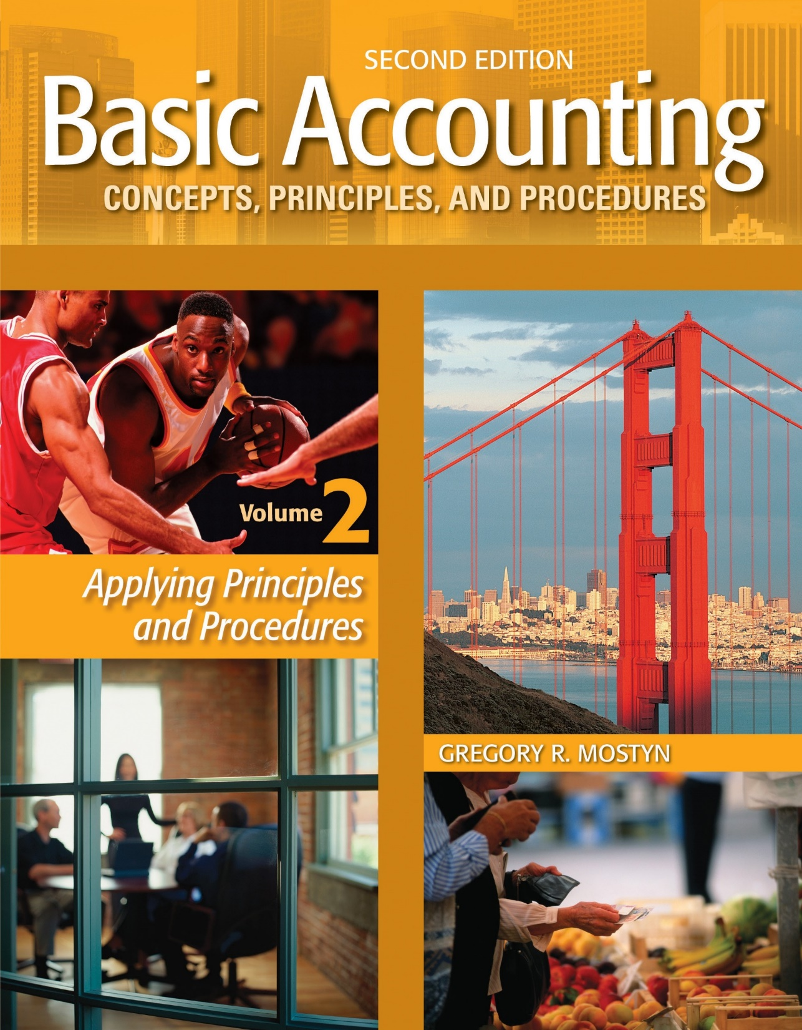
Basic Accounting Concepts Principles and Procedures, 2nd Edition, Volume 1
Basic Accounting Concepts Principles and Procedures, 2nd Edition, Volume 2

Slide 2
Learning Goal 13

Slide 3
Perpetual Inventory Method
Overview
As discussed in Learning Goal 10, the perpetual inventory method continuously accounts for both cost of goods
sold and ending inventory. This is done on a daily basis as merchandise is purchased or sold.
• Determining cost of merchandise: Except in very simple circumstances, a computerized accounting system is
usually required. The system records the cost and number of units of each type of merchandise inventory
item purchased or sold.
When goods are purchased, the units and cost are added to the prior inventory balance to determine the new
inventory balance. The cost of goods purchased is recorded in a merchandise inventory account.
When goods are sold, the units and cost of goods sold are subtracted from the inventory balance to determine the
remaining (ending) inventory. The cost of goods sold is recorded in a cost of goods sold account.
• Even though the record-keeping is continuous, the ending inventory balance is verified at year-end by a physical
count.

Slide 4
Illustration
Perpetual Inventory Method
Net Sales $300,500
Lower Inventory
Minus
Cost of Goods Sold $180,300
Sell Inventory
Purchase Inventory
Equals
Gross Profit $120,200
Higher Inventory

Slide 5
Perpetual Inventory Method
Recording Purchases
• When merchandise is purchased, the purchase is recorded in a merchandise inventory account.
• Most inventory transactions are “on account” (using accounts payable).
Journal Entry: $900 of merchandise is purchased on account.
xxx | Merchandise Inventory | 900
 | Accounts Payable |  | 900

Slide 6
Perpetual Inventory Method
Recording Purchase Discounts
• A purchase discount is a discount recorded by a buyer for early payment
within a specified time period.
• The terms of a discount are called credit terms and are recorded on the
invoice sent from the seller to the buyer.
• An invoice is a bill that identifies items, price, quantity, and terms. A
buyer often refers to it as a “purchase invoice”. A seller often refers to it
as a “sales invoice”.

Slide 7
Perpetual Inventory Method
Purchase Discounts, continued
Examples of Common Discount Terms
Discount Terms | Interpretation
2/10/, n/30 | Read this as: “Two ten, net thirty”. It means: 2% discount if paid within 10 days, otherwise, balance is due in 30 days.
1/10/, n/15 | Read this as: “One ten, net fifteen”. It means: 1% discount if paid within 10 days, otherwise, balance is due in 15 days.
1/5 EOM, n/30 | Read this as: “One five EOM, net thirty”. It means: 1% discount if paid within 5 days from the end of the current month, otherwise, balance is due in 30 days.
n/30 | Read this as: “Net thirty”. It means: The full amount is due in 30 days. There is no discount.
• Counting days: The first day begins after the day of the sale.

Slide 8
Perpetual Inventory Method
Purchase Discounts, continued
Example #1: Full payment in discount period
• On February 19, Revel Company purchased $900 of merchandise, terms 2/10, n/30.
2/19 | Merchandise Inventory | 900
 | Accounts Payable |  | 900
Net cost of merchandise:
$900 - $18 = $882
• On February 28, the amount is paid in full.
2/28 | Accounts Payable | 900
 | Merchandise Inventory |  | 18
 | Cash |  | 882
Calculation: $900 X .02 = $18 discount, OR
$900 X .98 = $882 cash paid

Slide 9
Perpetual Inventory Method
Purchase Discounts, continued
Example #2: No payment in discount period
• On February 19, Revel Company purchased $900 of merchandise, terms 2/10, n/30.
2/19 | Merchandise Inventory | 900
 | Accounts Payable |  | 900
• On March 17, amount is paid in full.
3/17 | Accounts Payable | 900
 | Cash |  | 900
Calculation: No calculation. The buyer missed the discount.

Slide 10
Perpetual Inventory Method
Purchase Discounts, continued
Example #3: Partial payment in discount period
• On February 19, Revel Company purchased $900 of merchandise, terms 2/10, n/30.
2/19 | Merchandise Inventory | 900
 | Accounts Payable |  | 900
• On February 28, Revel made a $735 cash payment.
• On March 17, the Revel paid the balance due.
2/28 | Accounts Payable | 750
 | Merchandise Inventory |  | 15
 | Cash |  | 735
Calculation: Generally any payment within a discount period is net of the discount. This means the $735 is
after a 2% discount is applied, so it is 98% of some portion of the payable. $735/.98 = $750 debit to Accounts Payable.
The final payment is:
3/17 | Accounts Payable | 150
 | Cash |  | 150
Calculation: $900 – $750 = $150 remaining payable balance due.

Slide 11
Perpetual Inventory Method
• Caution: Especially for partial payments within a discount period, read payment information carefully!
• There is a difference between a cash payment and an invoice portion payment! A cash payment is a net amount.
An invoice portion is a gross amount.
Example #4: • On February 28, the buyer paid $735 of the invoice.
2/28 | Accounts Payable | 735
 | Merchandise Inventory |  | 14.70
 | Cash |  | 720.30
Calculation: $735 (gross amount) X .98 = $720.30 (net amount)
Example #5: • On February 28, the customer made a $735 cash payment.
2/28 | Accounts Payable | 750
 | Merchandise Inventory |  | 15
 | Cash |  | 735
Calculation: $735 (net amount) / .98 = $750 (gross amount)

Slide 12
Perpetual Inventory Method
Purchase Returns and Allowances
• A purchase return means that a buyer returns merchandise to a seller.
• A purchase allowance means that a buyer keeps the merchandise but receives a price reduction from the seller.
• In a perpetual inventory system, usually both purchase returns and purchase allowances are
recorded by a buyer as a credit (a reduction) to merchandise inventory. However a separate contra account called “purchase returns and allowances” can also be used. This would have a credit balance as an offset against Merchandise Inventory

Slide 13
Perpetual Inventory Method
Purchase Returns and Allowances, continued
Example #1: Buyer Company returns $1,000 of slightly damaged merchandise to Seller Company. The buyer makes the following journal entry:
xx | Accounts Payable | 1,000
 | Merchandise Inventory |  | 1,000
Example #2: Buyer Company keeps the above merchandise, but Seller Company gives Buyer Company a $200 allowance. The buyer makes the following journal entry:
xx | Accounts Payable | 200
 | Merchandise Inventory |  | 200

Slide 14
Perpetual Inventory Method
Purchase Returns and Allowances, continued
• When a purchase return or allowance is recorded, the buyer usually sends the seller a debit memorandum, called a “debit memo”. A debit memo confirms for the seller the amount that the buyer has debited (reduced) accounts payable.

Slide 15
Perpetual Inventory Method
Shipping Charges Paid by Buyer
• When a buyer pays for shipping (“freight”) charges the buyer records this as an additional cost of the merchandise inventory. It is also possible to record the shipping charges in a separate account called “freight-in” for more detailed cost analysis. Later, the freight-in is added to the inventory cost for reporting purposes.
Example: Buyer Company recorded a $1,500 purchase on account, and also paid $100 shipping charges.
xx | Merchandise Inventory | 1,500
 | Accounts Payable |  | 1,500
 | Merchandise Inventory | 100
 | Cash |  | 100

Slide 16
Perpetual Inventory Method
Shipping Charges Paid by Seller
• When a seller pays for shipping charges and the terms require the buyer to reimburse the seller, the seller adds the shipping charges to the invoice and the buyer records this as part of Accounts Payable when the purchase is made.
Example:
xx | Merchandise Inventory | 1,600
 | Accounts Payable |  | 1,600
Caution: Purchase discounts do not apply to freight charges. When calculating a purchase discount, the freight charges must be excluded. Here, a 2% purchase discount would be ($1,600 - $100) X .02 = $30.

Slide 17
Perpetual Inventory Method
Overview of Merchandise Inventory Account
 |  | Merchandise Inventory |  |  |  |  |  |  | Cost of Goods Sold
Beginning inventory |  |  | 20,000 | 3,100
Purchases |  |  | 120,000 | 2,200 |  |  |  |  |  | 127,000
Freight-in |  |  | 500
Cost available |  |  | 135,200
Cost of Goods Sold |  |  |  | 127,000
Ending inventory |  |  | 8,200
Returns/Allow Discounts
Discounts
• The illustration above summarizes a merchandise inventory account over an accounting period.
• In practice there would be journal entries for individual transactions. As well, a merchandise inventory account would be maintained for each type of inventory. Unit costs would be calculated for each type of inventory.

Slide 18
Perpetual Inventory Method
Ending Inventory
• Ending inventory is an asset that is the cost of the merchandise inventory still on hand at the end of an accounting period, after all transactions for the period are completed.
• To determine the cost of ending inventory two steps are required:
1) Physical count of units on hand: The number of owned units on hand must be counted. The units are then multiplied by the unit cost to determine total cost.
2) Merchandise in transit: Merchandise can change ownership in the shipping process. The terms of the purchase must be checked to determine when title (ownership) transfers from seller to buyer. This is often at the designated “FOB point”.
• Consignment goods means merchandise that has been shipped to a merchant, but that merchant does not own the merchandise. Consignment goods should be included as part of the asset ending inventory only for the shipper, not the merchant that has them on hand.

Slide 19
Perpetual Inventory Method
Recording Revenue
• The fundamental principle for revenue recognition is to record revenue
when it is earned, regardless of when cash is received. This is usually at
the point of sale, when:
• The seller delivers what was agreed upon at the agreed price, and
• The buyer can reasonably be expected to pay or has paid

Slide 20
Perpetual Inventory Method
Recording Revenue, continued
• For goods that are being shipped, in most circumstances the point of delivery is considered to be the FOB point. The term “FOB” means “Free on board” and refers to the point at which ownership is considered to transfer from seller to buyer.
Examples: Merchandise is being shipped by truck from Chicago to Los Angeles.
#1) The shipping terms specify “FOB shipping point”: This means the sale is recognized when the goods are loaded on the truck in Chicago. At this point the buyer owns the merchandise. Buyer must also pay freight from Chicago and assume risk of loss (if no insurance).
#2) The shipping terms specify “FOB delivery point”: The sale would not take place until the goods are unloaded in Los Angeles. Seller would pay freight to Los Angeles and assume risk of loss.

Slide 21
Perpetual Inventory Method
Net Sales
• When there are circumstances that reduce the amount of sales revenue, the reduced revenue is called “net sales”. In accounting, the word “net” means a reduced amount, after something has been subtracted from a larger amount.
• The two most common items that reduce sales are sales returns and allowances and sales discounts.
• Sales returns and allowances occur when a buyer returns unsatisfactory merchandise or receives a credit allowance from the seller. Example: A company reports gross sales of $10,000 and sales returns and allowances of $1,000. Net sales are $9,000.
• Sales discounts occur when a seller offers a price reduction if the buyer pays quickly or meets other requirements.

Slide 22
Periodic Inventory Method
Net Sales Illustrated
Sales $320,000
Less:
Sales Returns
& Allowances..... $ 4,500
Sales Discounts..... 15,000
19,500
Net sales $300,500
Net Sales $300,500
Minus
Cost of Goods Sold $180,300
Equals
Gross Profit $120,200

Slide 23
Perpetual Inventory Method
Recording Sales
• The document that provides the sales information is called a “sales invoice”.
A sales invoice is the seller’s copy of the bill sent to the buyer. It identifies date, merchandise type, quantity, price, payment terms, and other terms such as possible discounts and shipping terms.
• With the perpetual inventory method, cost of goods sold is always recorded when a sale is recorded.
Example #1: The journal entry below records a $3,000 June 15 merchandise sale on account, with a merchandise cost of $1,500:
6/15 | Accounts Receivable | 3,000
 | Sales |  | 3,000
 | Cost of Goods Sold | 1,500
 | Merchandise Inventory |  | 1,500

Slide 24
Perpetual Inventory Method
Recording Sales, continued
Example #2: The journal entry below records a $3,000 June 15 merchandise sale, with a merchandise cost of $1,500. The sale is a cash sale.
6/15 | Cash | 3,000
 | Sales |  | 3,000
 | Cost of Goods Sold | 1,500
 | Merchandise Inventory |  | 1,500

Slide 25
Perpetual Inventory Method Recording Sales, continued
• Calculating sales discounts: The calculations for sales discounts are the same as previously discussed for
merchandise purchases.
• Recording sales discounts: A seller records a sales discount if a buyer makes a payment within a discount
period. The seller debits a sales discounts account, which is a contra-sales account.
Example #1: On June 15, Seller Company sold $5,000 of merchandise to Buyer Company, terms 2/10, n/30. On
June 24, Buyer Company paid in full. The payment is within the discount period.
6/24 | Cash | 4,900
 | Sales Discounts | 100
 | Accounts Receivable |  | 5,000
Example #2: On June 15, Seller Company sold $5,000 of merchandise to Buyer Company, terms 2/10, n/30. On
June 30, Buyer Company paid in full. Buyer Company has missed the discount.
6/30 | Cash | 5,000
 | Accounts Receivable |  | 5,000

Slide 26
Perpetual Inventory Method
Recording Sales, continued
• A sales return means that a buyer returns merchandise to a seller.
• A sales allowance means that a buyer keeps the merchandise but receives
a price reduction from the seller.
• Usually both sales returns and sales allowances are recorded by a seller in a single account called “sales returns
and allowances”. However, with the perpetual method, when merchandise is returned, the merchandise
inventory account is also debited, and cost of goods sold is credited, which reduces cost of goods sold.
• A sales returns and allowances account is a contra-sales account. This means that it is a companion offset
account against a sales account.

Slide 27
Perpetual Inventory Method
Recording Sales, continued
Example #1: Buyer Company returns $1,000 of slightly damaged merchandise to Seller Company. The seller determines that the cost of the merchandise is $600. The seller makes the following journal entries:
xx | Sales Returns and Allowances | 1,000
 | Accounts Receivable |  | 1,000
 | Merchandise Inventory | 600
 | Cost of Goods Sold |  | 600
Example #2: Buyer Company keeps the above merchandise, but Seller Company gives Buyer Company a $200 allowance.
xx | Sales Returns and Allowances | 200
 | Accounts Receivable |  | 200
Seller Company does not make an entry to Merchandise Inventory or Cost of Goods Sold because the buyer
keeps the merchandise.

Slide 28
Perpetual Inventory Method
Recording Sales, continued
• When a sales return or allowance is recorded, the seller usually sends the buyer a credit memorandum, called a
“credit memo”. A credit memo confirms for the buyer the amount that the seller has credited (reduced)
accounts receivable.

Slide 29
Perpetual Inventory Method
Sales Tax
• Sales tax is a tax levied by a state or local taxing authority as a percentage of designated retail sales, called taxable sales. It is the buyer of this merchandise that pays sales tax.
• A seller collects sales tax as part of total sales and records the tax as a liability called “sales tax payable”.
Example: Merchant Company sold $500 of taxable merchandise, with a cost of $300. The sales tax rate is 6%.
xx | Cash | 530
 | Sales |  | 500
 | Sales Tax Payable |  | 30
 | Cost of Goods Sold | 300
 | Merchandise Inventory |  | 300

Slide 30
Perpetual Inventory Method
Sales Tax, continued
• At specified intervals, a seller pays the total tax collected to the taxing authority.
Example: Suppose that Merchant Company had $10,000 of taxable sales during the month and collected $600 in sales tax. After the end of the month Merchant Company must pay the $600 to the taxing authority.
xx | Sales Tax Payable | 600
 | Cash |  | 600
• Merchant Company is merely a collection agent for the taxing authority. The sales tax is neither a revenue nor an expense.

Slide 31
Perpetual Inventory Method
Sales Tax, continued
• Shortcut: Sometimes sellers use a shortcut to record sales tax by including the sales tax as part of sales revenue. Because this is not technically correct, this requires a later calculation to determine the correct tax.
Example: Merchant Company sold $500 of taxable merchandise, with a cost of $300. The sales tax rate is 6%. Merchant company records the sale as:
xx | Cash | 530
 | Sales |  | 530
 | Cost of Goods Sold | 300
 | Merchandise Inventory |  | 300
• During the period, Merchant Company continues to record taxable sales in this manner, until correct sales tax must be calculated and paid to the taxing authority.

Slide 32
Perpetual Inventory Method
Sales Tax, continued
Example: At the end of the period Merchant Company has recorded $10,600 of “sales”, which actually includes sales tax. The sales tax calculation is:
• $10,600 / 1.06 = $10,000 sales. • $10,600 – $10,000 = $600 sales tax.
The journal entry is:
xx | Sales | 600
 | Sales Tax Payable |  | 600
• Reason for the calculation: The recorded sales amount is actually 106% of the correct sales.
• Note: It would be incorrect to calculate sales tax as $10,600 X .06 = $636. Doing this would be calculating sales tax on an amount that already includes sales tax.

