Slide 1
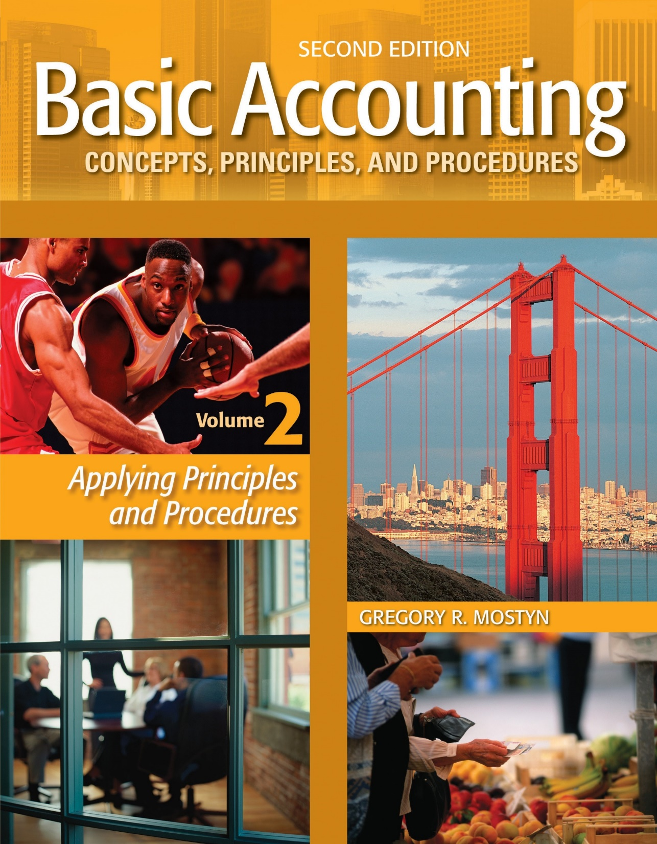
Basic Accounting Concepts Principles and Procedures, 2nd Edition, Volume 1
Basic Accounting Concepts Principles and Procedures, 2nd Edition, Volume 2

Slide 2
Learning Goal 21 Part 2

Slide 3
Overview of The Direct Method
• The direct method is a method for calculating cash flow from operating activities. It is an alternative format to the indirect method. Both methods are acceptable for GAAP.
• The direct method looks at each line item of the income statement. Adjustments are made to each line item as needed, to determine cash inflows (revenue related) and cash outflows (expense related).
• In this way, the direct method “works its way down” the income statement one line at a time, until it is fully converted to cash basis.

Slide 4
Procedure
Step #1: Examine each revenue item. Use the revenue adjustments table below to adjust each revenue item as needed to cash basis. (Cash inflows)
Step #2: Examine cost of goods sold. Use the cost of goods sold adjustments table below to adjust cost of goods sold to cash basis. (Cash outflows)
Step #3: Examine each remaining expense item. Use the expense adjustments table below to adjust each expense item as needed to cash basis. (Cash outflows)
Step #4: Total the adjusted amounts and properly format the items. Exclude non-cash expenses such as depreciation and amortization from the total, and exclude gains and losses.
Examples: The following examples use the income statement and balance sheet information shown on the next slides.

Slide 5
XYZ, Inc. Income Statement For the Year Ended December 31, 2020
 | Net sales revenue................................ |  |  | $360,000
 | Cost of goods sold............................... |  |  |  | 234,500
 | Gross profit.......................................... |  |  |  | 125,500
 | Operating expenses
 | Wages expense............................... |  |  | $31,180
 | Rent expense.................................. |  |  | 23,500
 | Advertising expense....................... |  |  | 15,120
 | Supplies expense............................ |  |  | 5,100
 | Utilities expense............................. |  |  | 7,050
 | Depreciation expense..................... |  |  | 3,800
 | Total operating expenses........... |  |  |  | 85,750
 | Operating income.............................. |  |  |  | 39,750
 | Other revenue, gains, expenses, and losses
 | Gain on sale of equipment............. |  |  | 750
 | Interest income.............................. |  |  | 1,000
 | Total other items.................... |  |  |  | 1,750
 | Income before tax.............................. |  |  |  | 41,500
 | Income tax expense........................ |  |  |  | 9,100
 | Net income.............................. |  |  |  | $32,400

Slide 6
Comparative Balance Sheets (Partial)
 |  |  |  | 2020 |  | 2019 |  | Dollar change
 |  | Current assets
 |  | Cash |  | $90,100 |  | $79,300 |  | $10,800
 |  | Accounts receivable |  | 44,350 |  | 48,720 |  | (4,370)
 |  | Merchandise inventory |  | 77,960 |  | 69,800 |  | 8,160
 |  | Prepaid rent |  | 2,500 |  | 3,500 |  | (1,000)
 |  | Supplies |  | 5,240 |  | 3,000 |  | 2,240
 |  | Total current assets |  | 220,150 |  | 204,320 |  | 15,830
 | Current liabilities
 | Wages payable |  | $30,500 |  | $47,600 |  | ($17,100)
 | Accounts payable |  | 44,350 |  | 38,150 |  | 6,200
 | Unearned revenue |  | 41,810 |  | 23,740 |  | 18,070
 | Total current liabilities |  | 116,660 |  | 109,490 |  | 7,170

Slide 7
Step #1: Revenue Adjustments
(Cash Inflows)
Revenue Item | Current Asset Adjustment | Current Liability Adjustment | Cash Collection
Net Sales $360,000 | + $4,370 | + $18,070 | $382,440
Interest $1,000 | -0- | -0- | $1,000
Total $361,000 | + $4,370 | + $18,070 | $383,440
Revenue Adjustments Table
Revenue Item | Current Asset Adjustments | Current Liability Adjustments
Sales | + Decrease in a receivable – Increase in a receivable | + Increase in unearned revenue – Decrease in unearned revenue
Other revenues | Same as above | Same as above

Slide 8
Step #2: Cost of Goods Sold Adjustments
(Cash Outflow)
Cost of Goods Sold | Current Asset Adjustment | Current Liability Adjustment | Cash Payment
$234,500 | + $8,160 | – $6,200 | $236,460
Cost of Goods Sold Adjustments Table
Current Asset Adjustments | Current Liability Adjustments
+ Increase in Merchandise Inventory – Decrease in Merchandise Inventory | + Decrease in Accounts Payable – Increase in Accounts Payable
Note: The accounts payable must be identified as connected to merchandise inventory. Non-inventory payables such as for accrued expenses are used as adjustments to the other expense items.
Here we assume all accounts payable are for merchandise inventory.

Slide 9
Step #3: Expenses Adjustments
(Cash Outflows)
Expense Item | Current Asset Adjustment | Current Liability Adjustment | Cash Payment
Wages: $31,180 | -0- | + $17,100 | $48,280
Rent: $23,500 | – $1,000 | -0- | $22,500
Advertising: $15,120 | -0- | -0- | $15,120
Supplies: $5,100 | + $2,240 | -0- | $ 7,340
Utilities: $7,050 | -0- | -0- | $ 7,050
Income tax: $9,100 | -0- | -0- | $ 9,100
Total: $91,050 | + $1,240 | + $17,100 | $109,390
Expenses Adjustments Table
Current Asset Adjustments | Current Liability Adjustments
+ Increase in prepaid or other current asset related to the expense. – Decrease in prepaid or other current asset related to the expense. | + Decrease in related liability – Increase in related liability

Slide 10
Step #4
XYZ Company, Inc.
Statement of Cash Flows
For the Year Ended December 31, 2020
Cash flows from operating activities
Receipts
Collections from customers.................... | $382,440
Interest.................................................... | 1,000
Total receipts.......................................... |  |  | $383,440
Payments
Merchandise inventory............................ | 236,460
Wages...................................................... | 48,280
Rent.......................................................... | 22,500
Advertising............................................... | 15,120
Supplies.................................................... | 7,340
Utilities.................................................... | 7,050
Income tax............................................... | 9,100
Total payments........................................ |  |  | 345,850
Net cash provided by operating activities |  |  | 37,590
Note: GAAP requires that when a statement of cash flows uses the direct method, the indirect method for operating activities should also be presented below the statement of cash flows to reconcile to net income.

