Slide 1
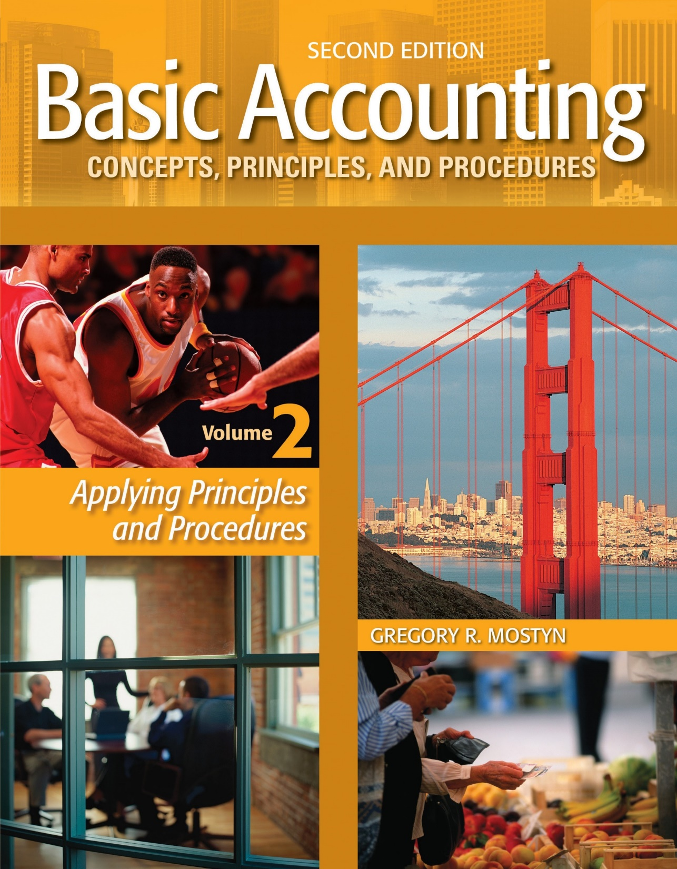
Basic Accounting Concepts Principles and Procedures, 2nd Edition, Volume 1
Basic Accounting Concepts Principles and Procedures, 2nd Edition, Volume 2

Slide 2
Corporations: Review and Essential Accounts

Slide 3
Comparison to Proprietorship
• The essential difference between a corporation and a proprietorship is how the equity of the owner(s) is reported.
• In a proprietorship there is one owner, and the owner’s claim on the business assets (business wealth) is called owner’s equity. • Owner's equity appears in the accounting equation as: A = L + OE , which is the basic structure of a proprietorship balance sheet.
• In a corporation there can be one or more owners, and the claim on business assets is called stockholders’ equity. • Stockholders' equity appears in the accounting equation as: A = L + SE , which is the basic structure of a corporate balance sheet.

Slide 4
Proprietorship Owner's Equity Accounts
• There are four owner’s equity accounts in a proprietorship.
1) The basic account is called the capital account. Owner investments are
recorded directly in the capital account.
2) The revenue accounts record revenues each accounting period, and
increase owner’s equity
3) The expense accounts record expenses each accounting period, and
decrease owner’s equity.
4) The drawing (withdrawals) account records owner withdrawals of assets,
which decrease owner's equity.
• To record the cumulative effect of all revenues, expenses, and withdrawals,
these final account balances are all combined into the capital account. This
also simplifies reporting owner's equity on the balance sheet. It is reported
using the owner’s name, such as “Bill Smith, Capital”.

Slide 5
Corporation Stockholders' Equity Accounts
• Although a corporation can have numerous types of equity accounts, in the basic corporate structure, there are 5 stockholder equity accounts.
1) The basic investment account is called common stock. This shows the amount that investors have paid into the corporation, by purchasing shares of the corporate stock. Any kind of stock is referred to by the general name of paid-in-capital.
2) The revenue accounts record revenues each accounting period, and increase stockholders' equity.
3) The expense accounts record expenses each accounting period, and decrease stockholders' equity.
4) Some corporations use a dividends account to record distributions to stockholders. Dividends are like withdrawals in a proprietorship.
5) To record the cumulative effect of all revenues, expenses, and dividends, a corporation uses a retained earnings account that combines these final account balances. This also simplifies reporting stockholders' equity on the balance sheet.

Slide 6
Net Income and Net Loss
• Both proprietorships and corporations use revenue accounts and expense
accounts.
• If total revenue account balances are greater than total expenses, the
result is called net income, which is a net increase to the owner’s or
stockholders’ equity.
• If total expense account balances are greater than total revenues, the
result is called net loss, which is a net decrease to the owner’s or
stockholders’ equity.

Slide 7
Comparison Illustration
Proprietorship Equity
Corporation Equity
Paid-in Capital
• Common stock
(Owner Name), Capital
• Investments • Net income/Net Loss
Paid-in Capital
Common stock
Paid-in Capital
• Common stock
Retained Earnings
Net income/Net Loss
Withdrawals Account
Dividends Account

Slide 8
Financial Statements Are Linked Together
Watson Consulting Services, Inc. Income Statement For the Month Ended May 31, 2017
Revenues
Consulting service revenue.................................. |  |  | $12,900
Expenses
Salaries and wages expense................................... |  | $4,100
Rent expense.......................................................... |  | 2,500
Advertising expense............................................... |  | 1,300
Utilities expense .................................................... |  | 800
Total operating expenses.............................. |  |  | 8,700
Income before tax.................................................... |  |  | 4,200
Income tax expense.............................................. |  |  | 1,000
Net income............................................................... |  |  | $3,200
To statement of retained earnings on next page

Slide 9
Financial Statements Are Linked Together
$3,200 is from income statement on prior page
Watson Consulting Services, Inc. Statement of Retained Earnings For the Month Ended May 31, 2017
 | Retained earnings, May 1....................................... |  |  | $71,200
 | Add: net income..................................................... |  |  | 3,200
 | Less: dividends........................................................ |  |  | (1,500)
 | Retained earnings, May 31..................................... |  |  | $72,900
To balance sheet on next page.

Slide 10
72,900 is from statement of retained earnings on prior page
Watson Consulting Services, Inc. Balance Sheet May 31, 2017
 | Assets
 | Cash ............................................................................. |  |  | $73,500
 | Accounts receivable..................................................... |  |  | 26,300
 | Supplies........................................................................ |  |  | 1,800
 | Equipment.................................................................... |  |  | 32,000
 | Total assets...................................................... |  |  | $133,600
 | Liabilities and Stockholders’ Equity
 | Liabilities
 | Notes payable ...................................................... |  |  | $31,000
 | Accounts payable................................................. |  |  | 14,700
 | Total liabilities.................................................... |  |  | $45,700
 | Stockholders’ equity
 | Paid-in capital
 | Common stock...................................................... |  | $15,000
 | Retained earnings..................................................... |  | 72,900
 | Total stockholders’ equity.................................. |  |  | 87,900
 | Total liabilities and stockholders’ equity…...... |  |  | $133,600

Slide 11
Statements Summary
• The income statement reports revenues and expenses, which results in net
income or net loss. This is the net effect of operations on stockholders'
equity each accounting period.
• As previously indicated, the cumulative effect of revenues and expenses (net
income or net loss) and dividends are combined into retained earnings. The
statement of retained earnings shows the current accounting period changes
and balance of retained earnings.
• The balance sheet shows assets, liabilities, and stockholders' equity as of a
specific date, normally at the end of an accounting period. The structure of
a balance sheet is based on the accounting equation, which is why it
balances.
• Not illustrated here is the statement of cash flows, which explains the change
in cash during the current accounting period. The statement of cash flows is
discussed in a later learning goal.

